Slide 1
Renewable Energy Potential (reV) Harnessing Geospatial Data to Solve Energy Challenges
Galen Maclaurin, Anthony Lopez, Nick Grue, Dylan Hettinger, Ricardo Oliveira
Geospatial Data Science

Slide 2


Harnessing Geospatial Data to Solve Energy Challenges
The reV model is a platform for assessing renewable energy potential and its geospatial intersection with grid infrastructure and land use characteristics.

Slide 3

Answer the Big Questions of Energy Planning
What are the land-use requirements and impacts of increasing penetrations of renewable energy?
What are the transmission and integration costs of renewable energy deployment?
How are wind and solar generation likely to perform at specific sites?
What are optimal designs for wind and solar generation at specific sites?
Notes:
Coupling methodologies for maintaining spatiotemporal characteristics of variable renewable energy in spatially course capacity expansion and nodal-based production cost models

Slide 4
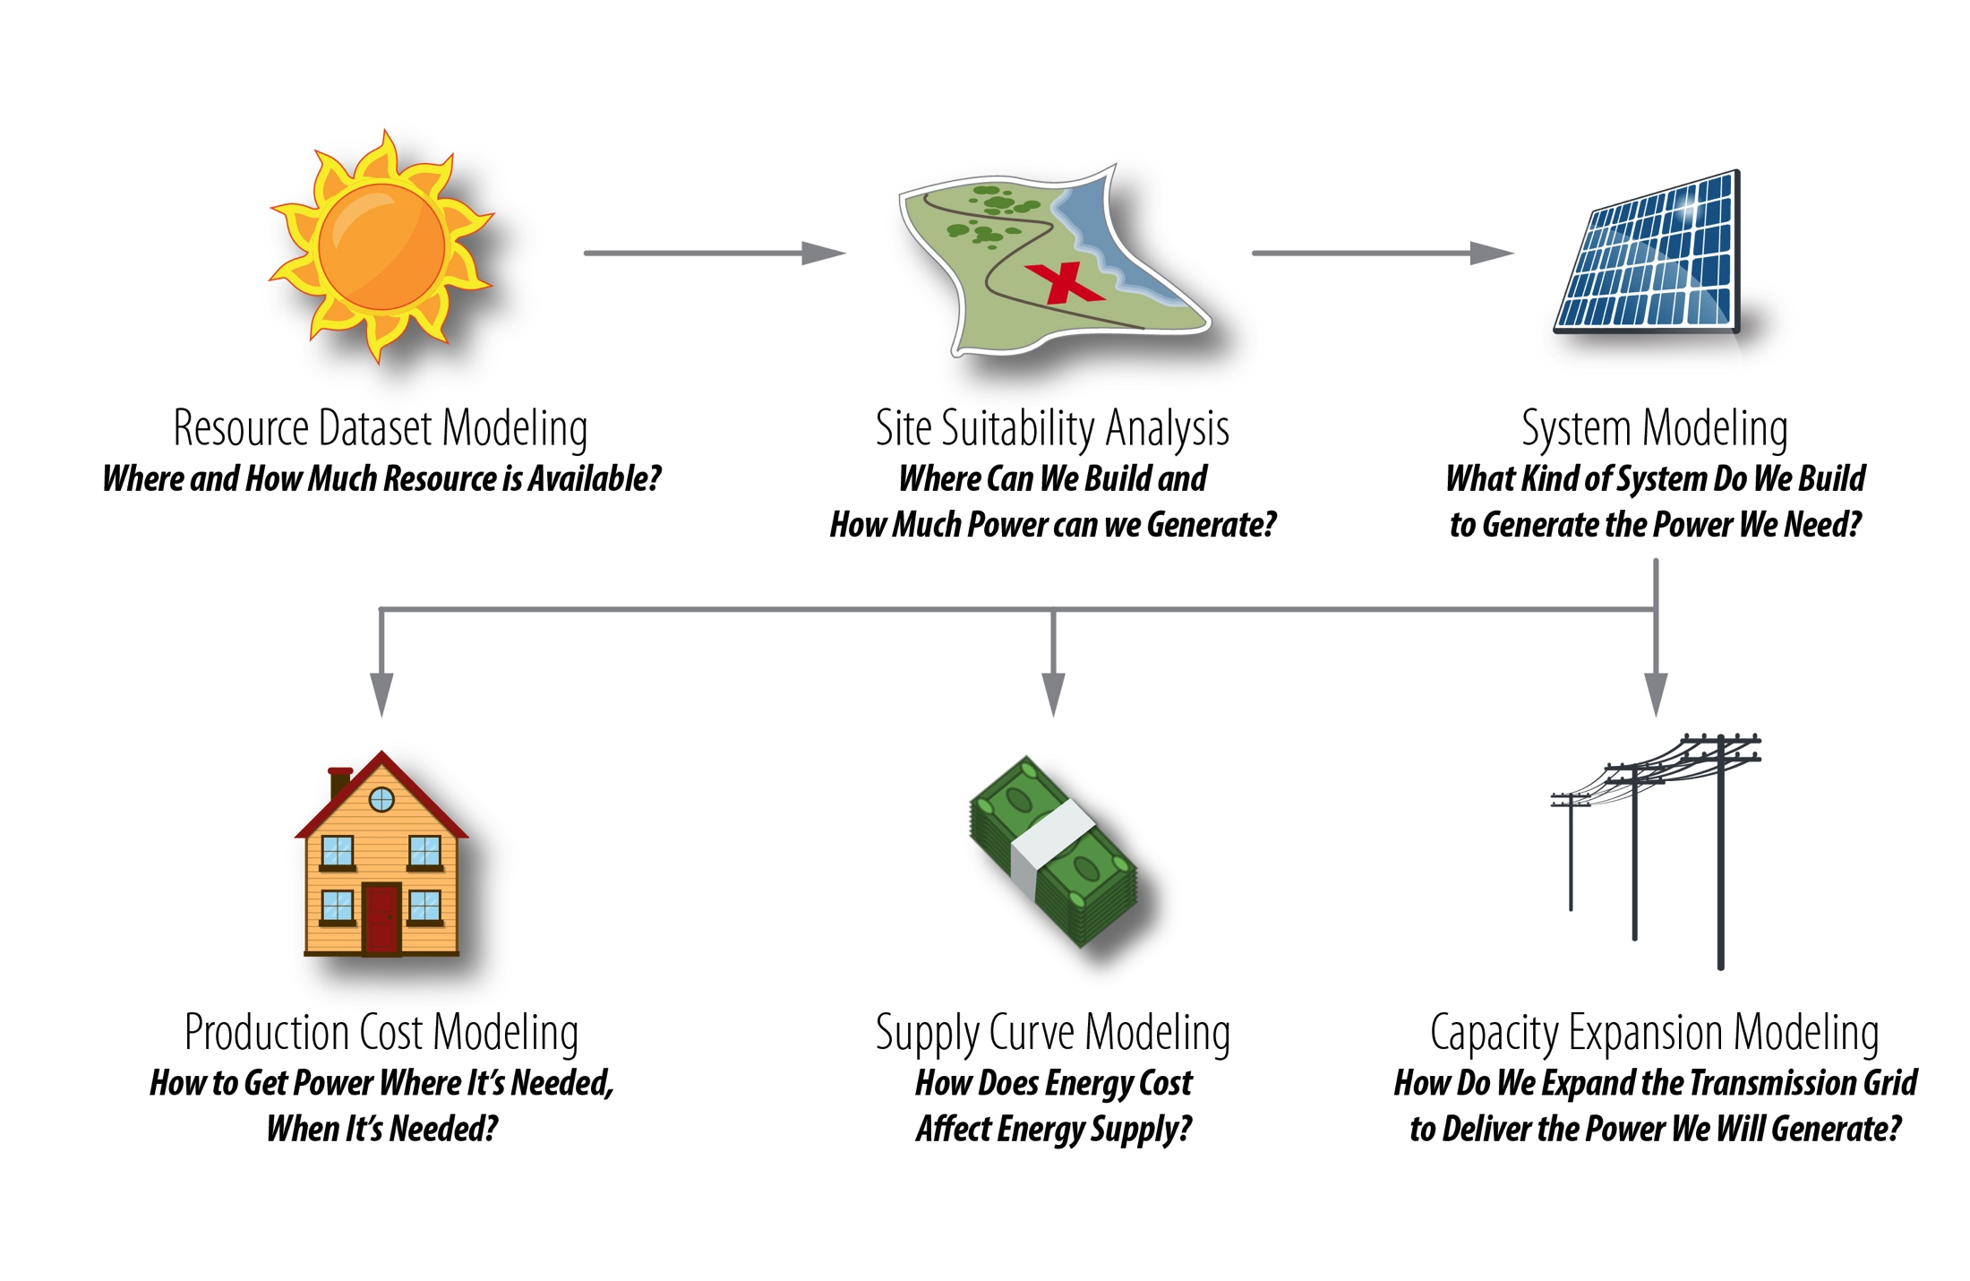
Initial Motivation

Slide 5
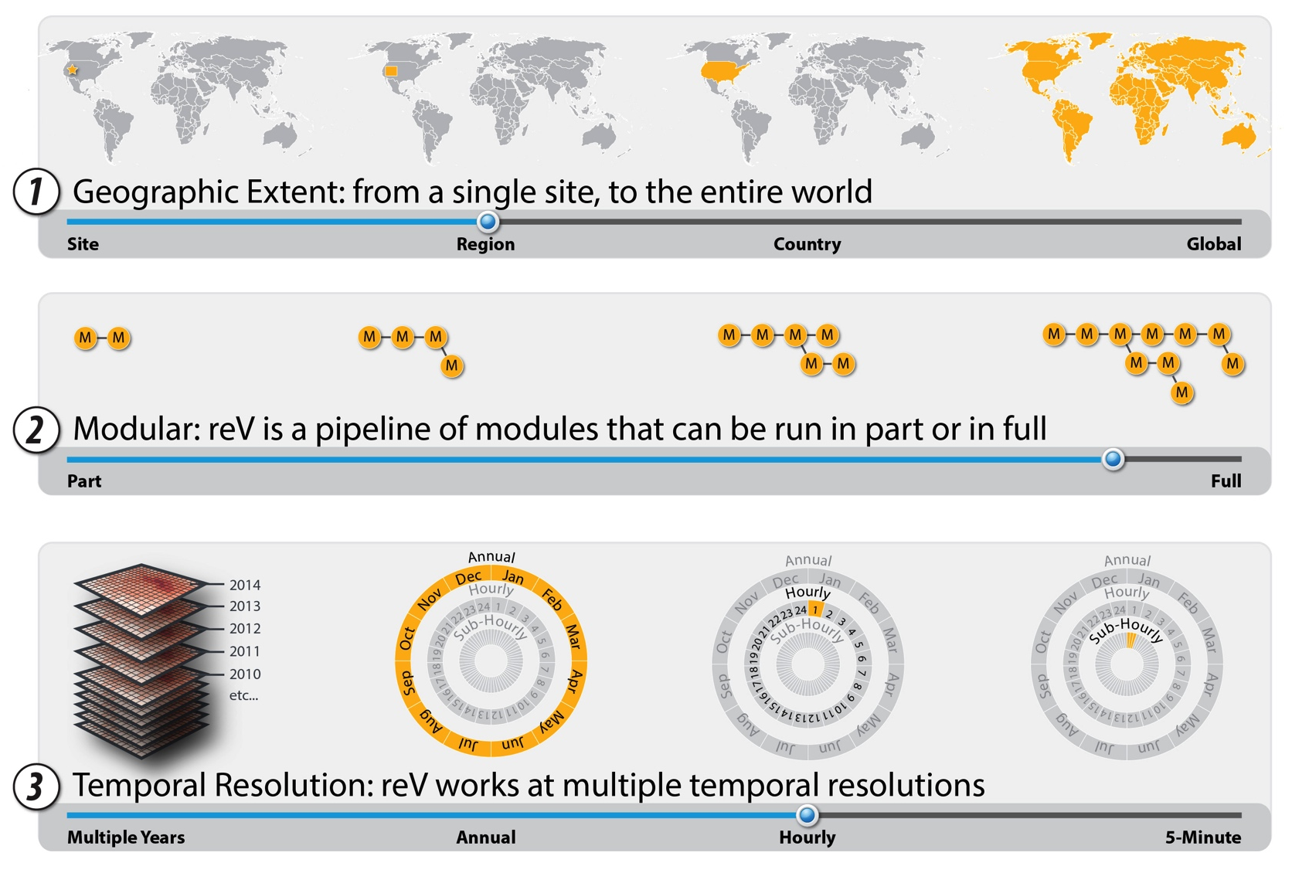
Need for Flexibility in Scope and Scale

Slide 6
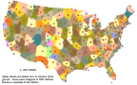
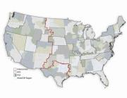

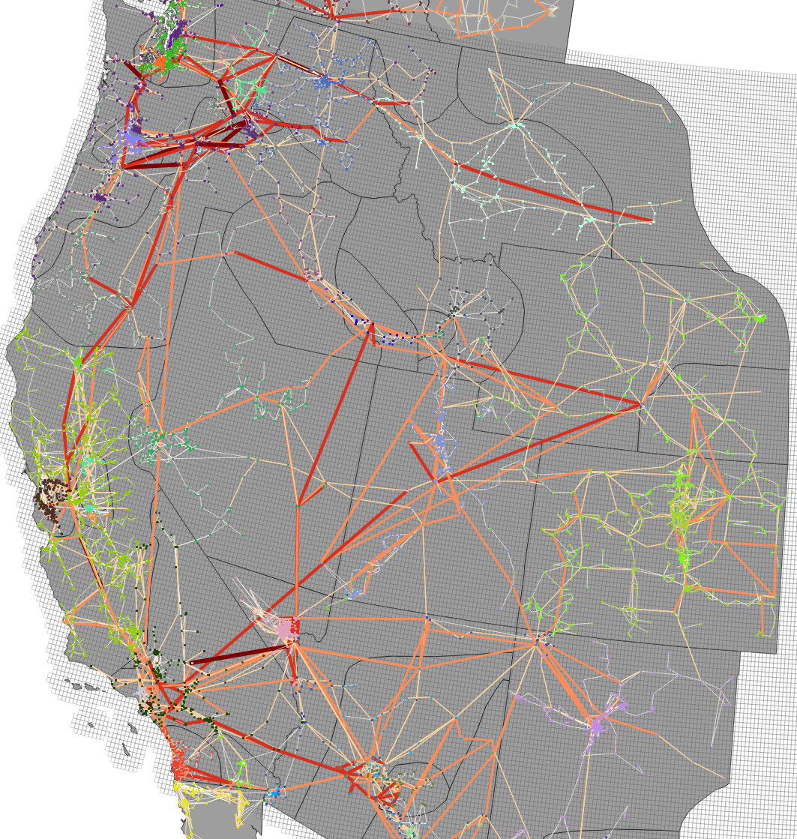

Model Coupling
IAMs
reV produces data for a diverse set of models, each with varying degrees of spatial and temporal requirements
Global
SolarDS
Rooftop PV adoption
U.S.
Capacity Expansion Models
ReEDS
National policy, market,
technology analysis
Geographic Scope
Regional/
Balancing Area
RPM
Regional integrated resource planning
PLEXOS
Security-constrained unit commitment & economic dispatch
System Models
Production Cost /
Grid Simulation Models
SAM
Hourly plant output
Generator
Annual
Seasonal/Diurnal
Hourly
Sub-hourly
Temporal Scope

Slide 7
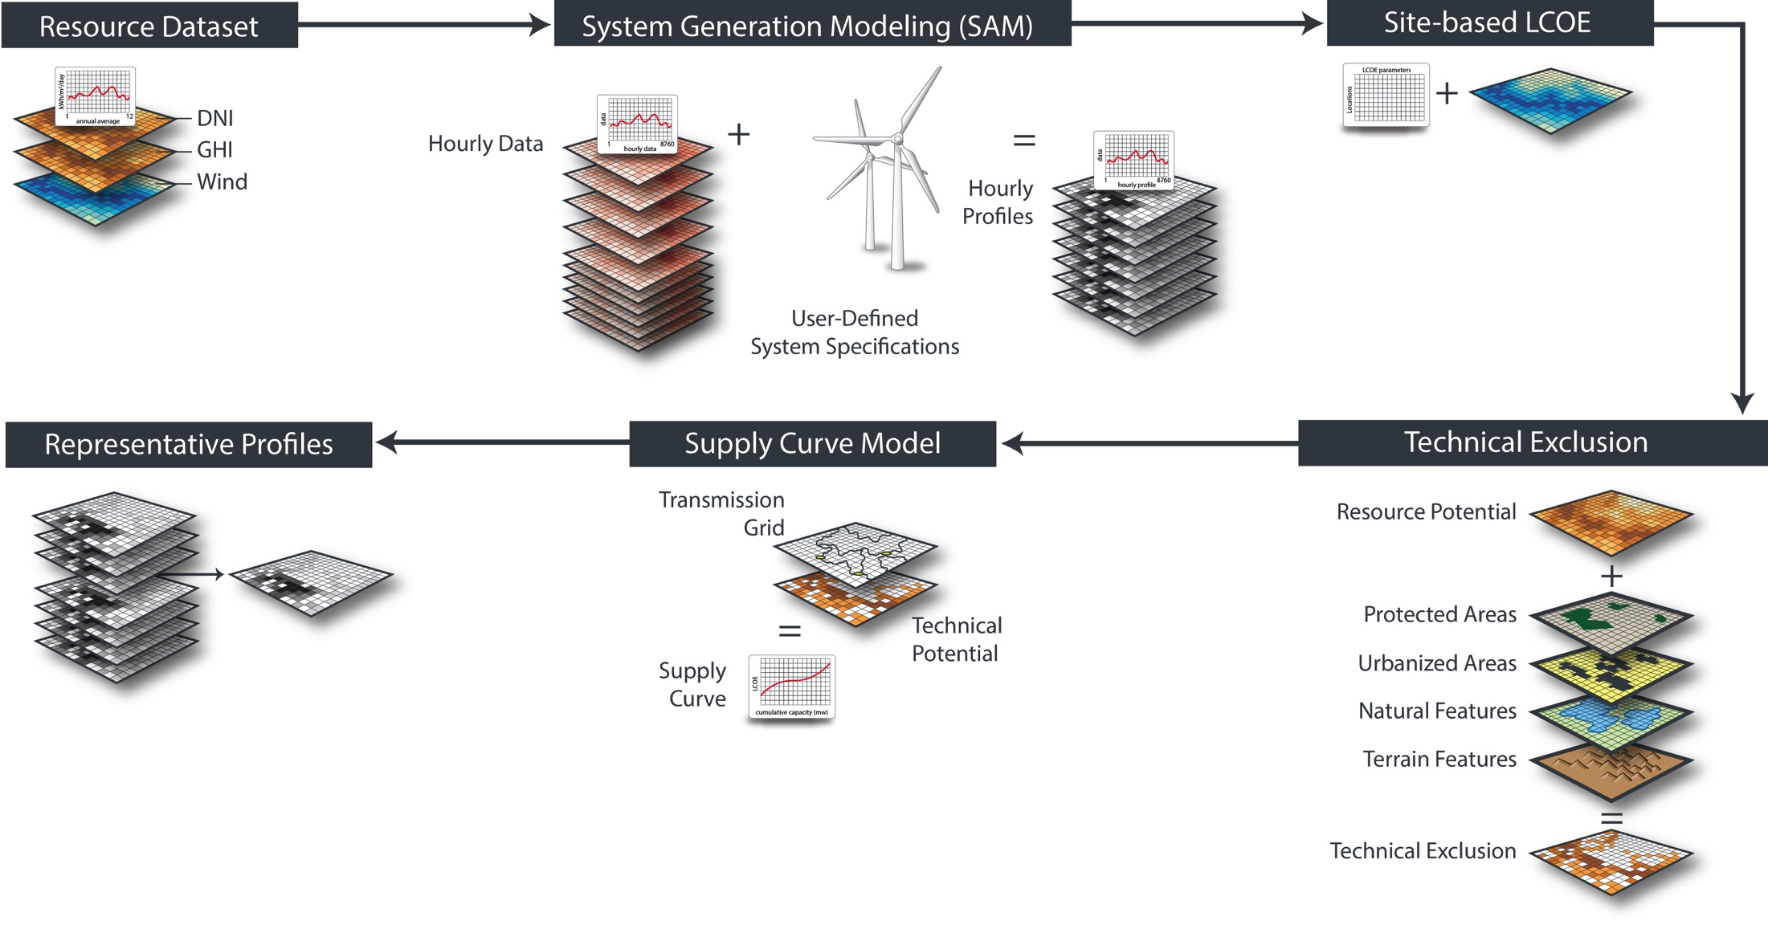
Principal modules of reV
reV lets you analyze renewable resources with techno-economic, regulatory, sociopolitical, and environmental factors

Slide 8
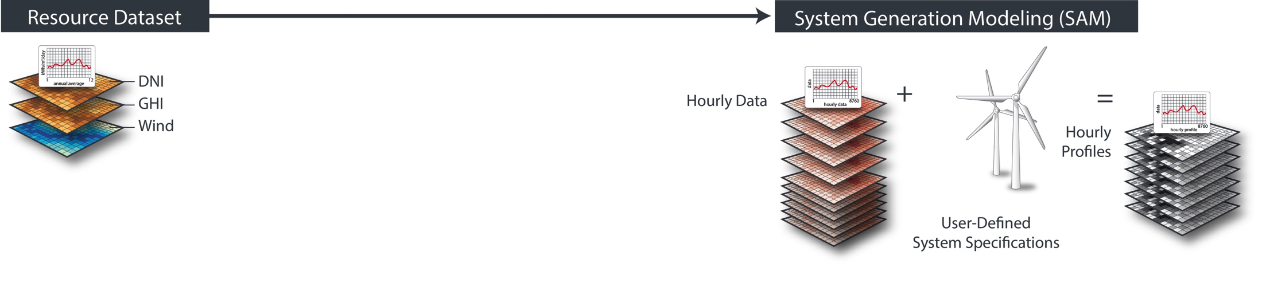
Principal modules of reV: Generation
The generation module batches SAM across millions of resource pixels (locations), allowing for multiple system configurations
Currently supported resource datasets:
NSRDB (solar)
Wind Toolkit – CONUS
SUNY South Asia (solar)
Planned future support:
Wind Toolkit – Mexico
Wind Toolkit - Canada
AWS wind
(e.g., system size, inverter ratio, tilt, etc.)
SAM modules currently supported:
pvwattsv5
windpower
Planned future support:
CSP

Slide 9
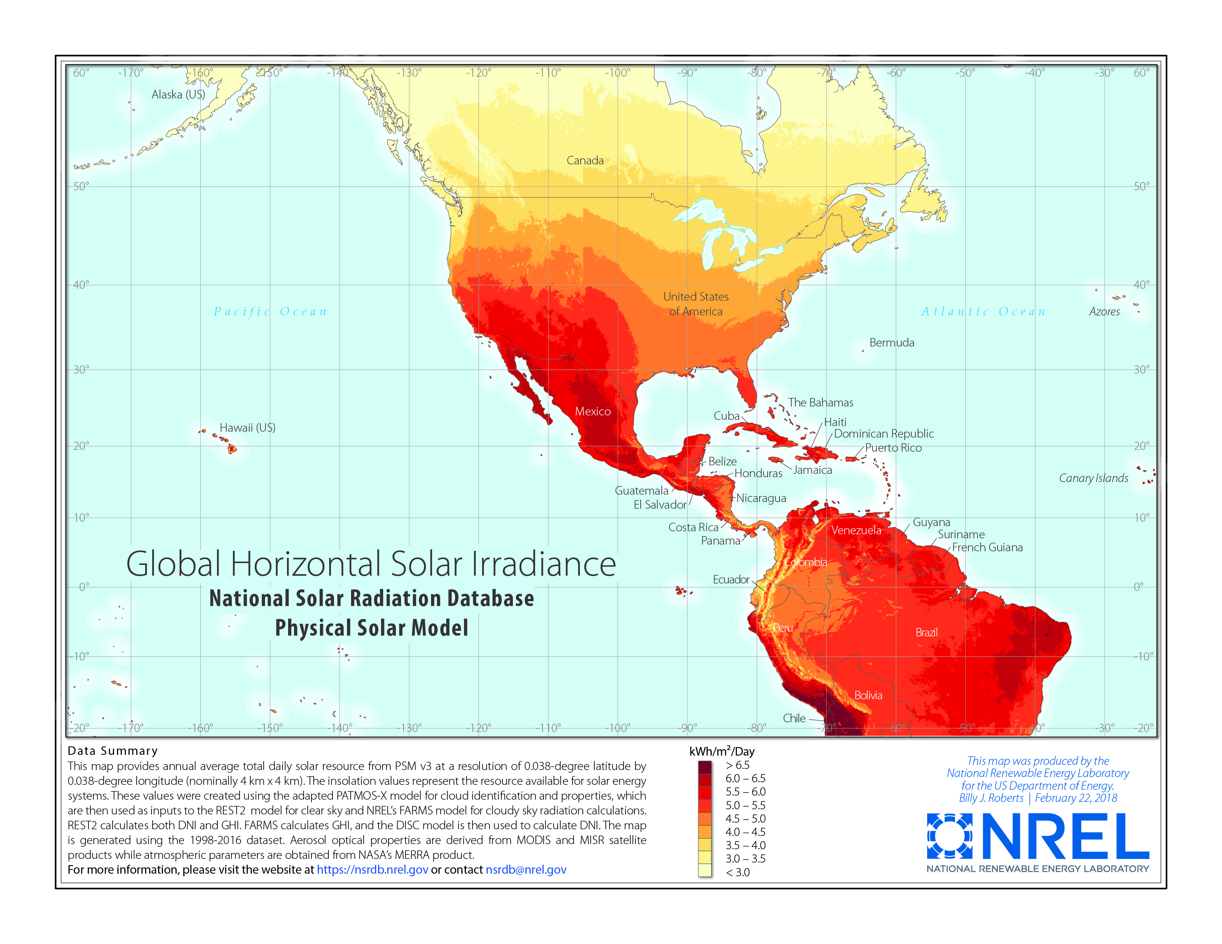
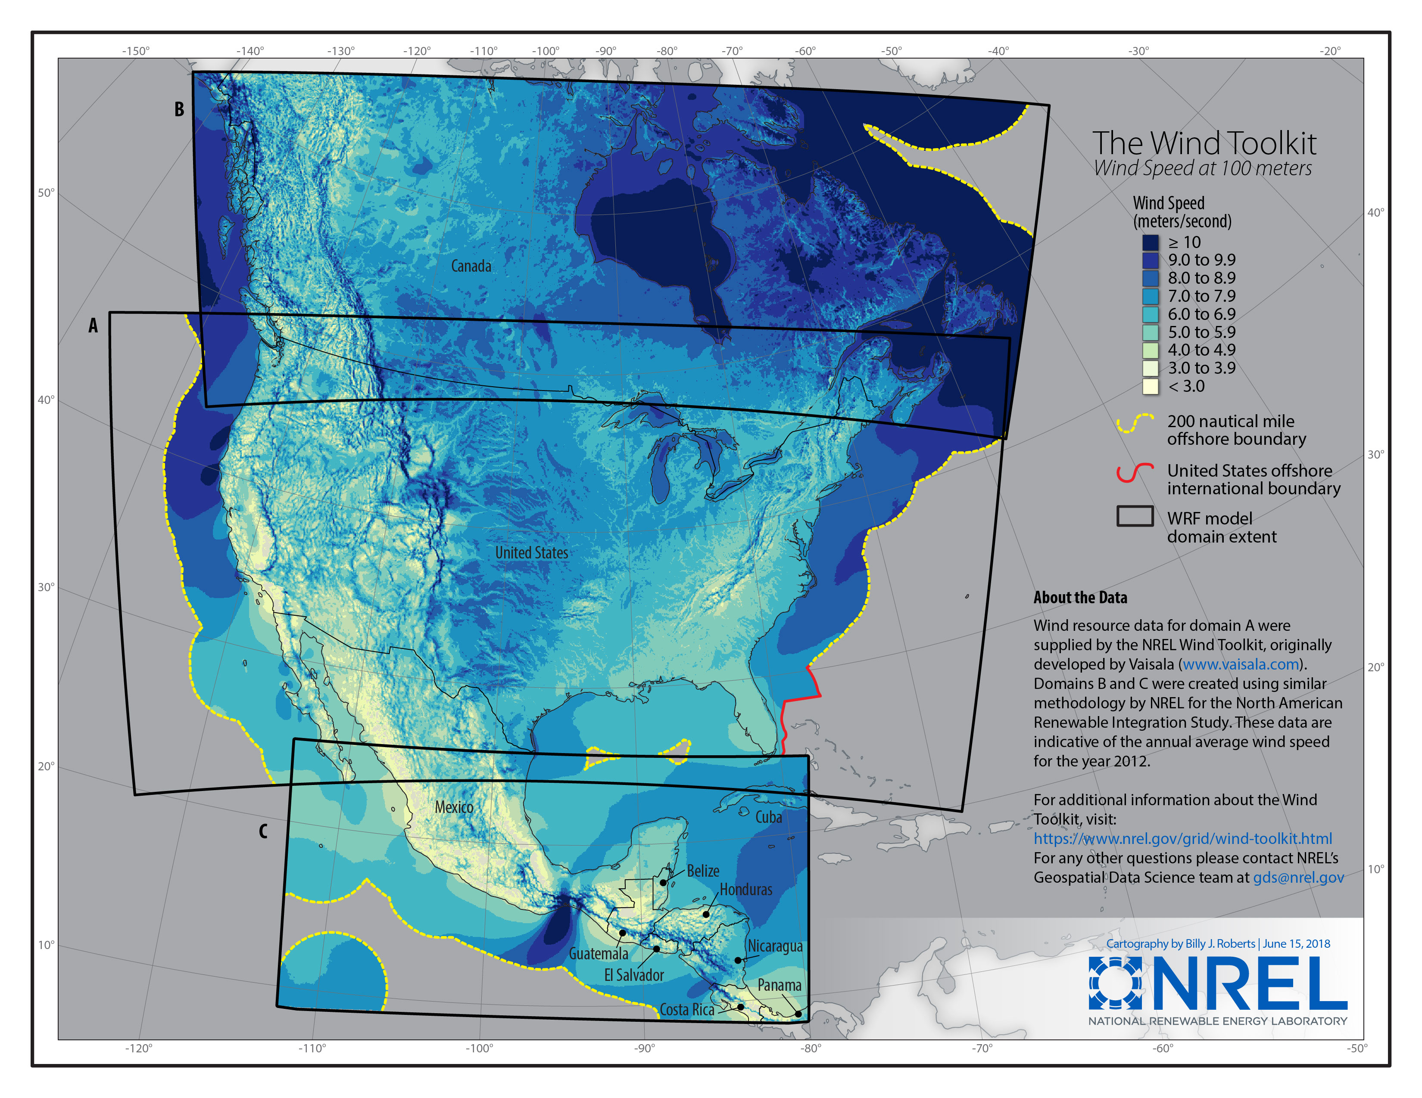
NREL Resource Data: The Americas
National Solar Radiation Database (NSRDB)
Temporal Range: 1998-2016
Temporal Interval: 30-minute
Spatial Resolution: nominal 4 km
Spatial Extent: Western Hemisphere and India (*coarser resolutions)
nsrdb.nrel.gov
WIND Toolkit
Temporal Range: 2007-2013
Temporal Interval: 5-minute
Spatial Resolution: nominal 2 km
Spatial Extent: North America
www.nrel.gov/grid/wind-toolkit.html

Slide 10
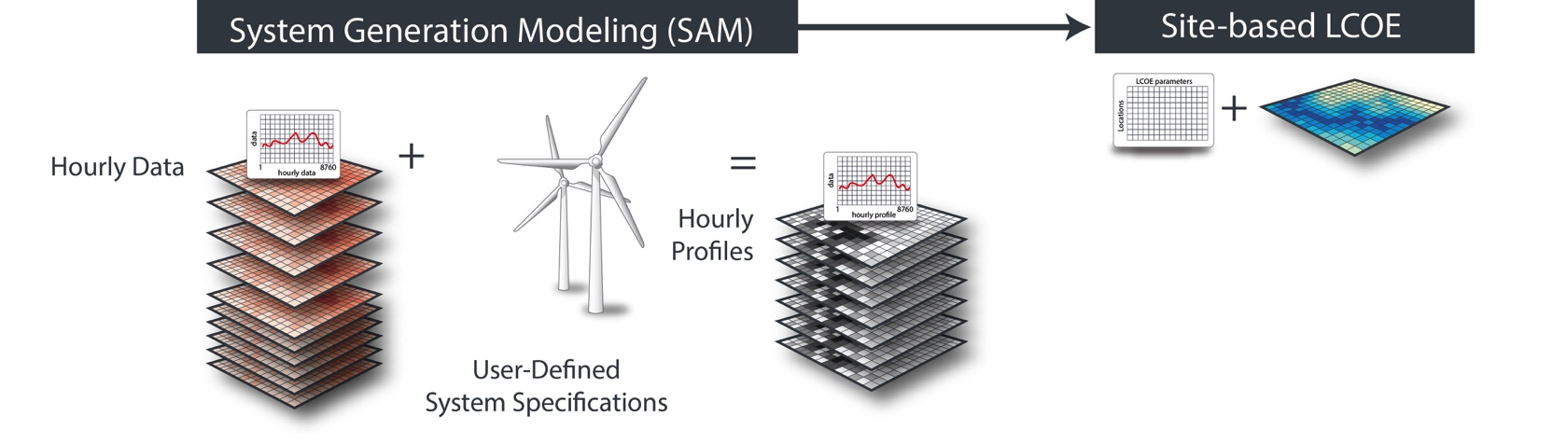
Principal modules of reV: LCOE
The LCOE module batches SAM LCOE on generation for all locations, allowing for multiple system configurations
Currently support the fixed charge rate method (FCR)
Future support could include other financial models

Slide 11
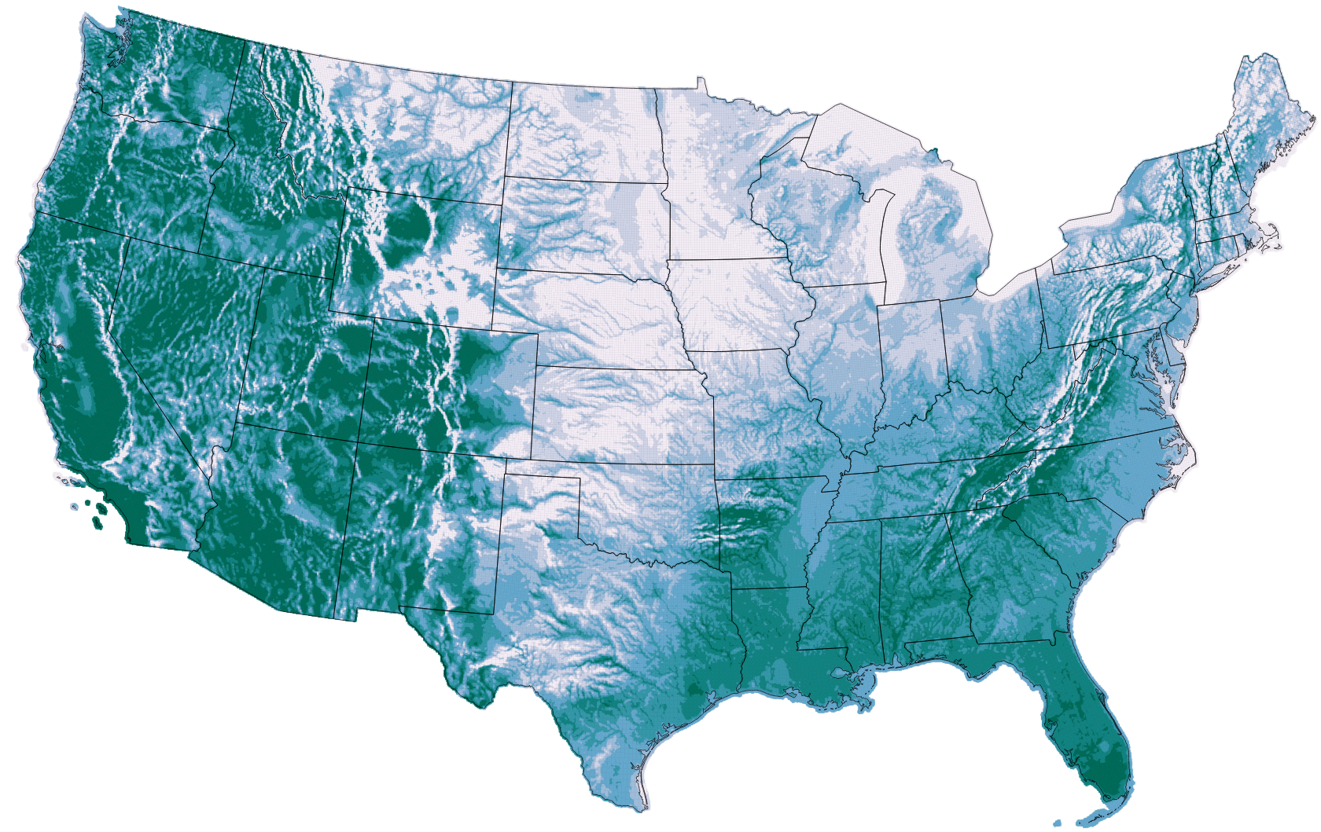
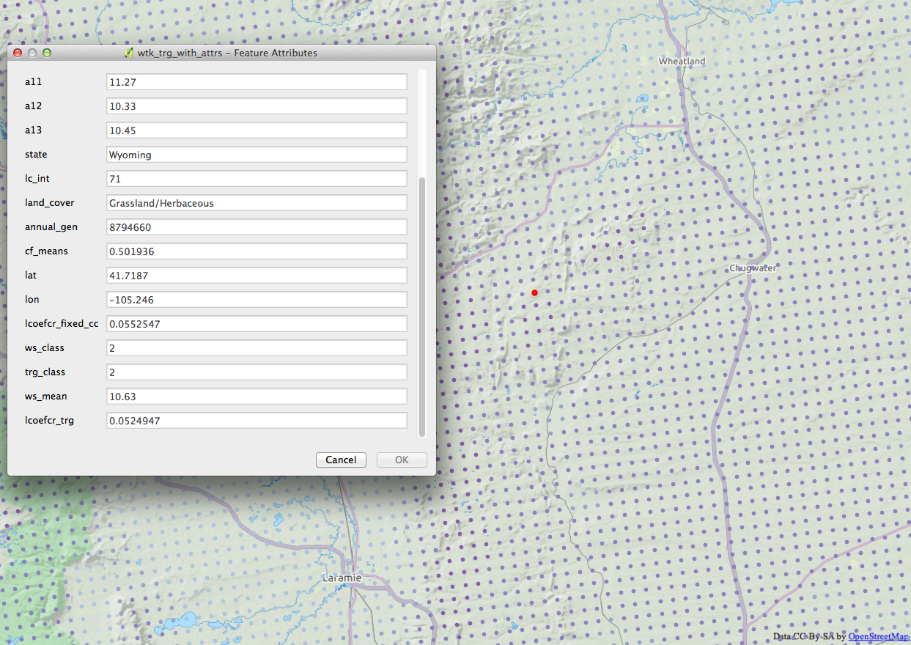
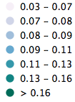
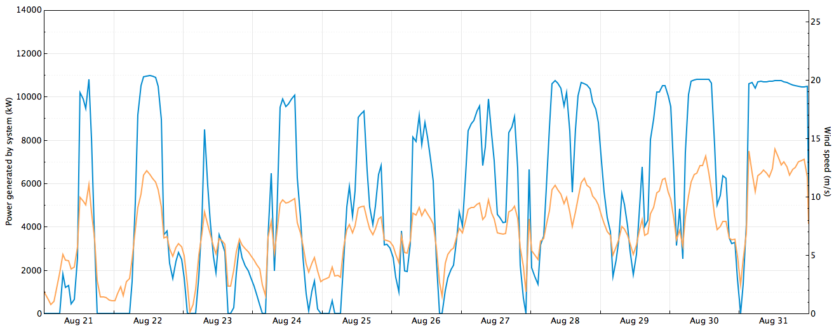
Principal modules of reV: Generation and LCOE
LCOE cents/kWh
Hourly generation / atmospheric conditions for each site
(have ability to go down to 5-minute in WTK or ½ hour in NSRDB)
Integration of the reV spatial database with SAM enables detailed site based assessment for different geographic extents
Notes:
1. reV + SAM
2. reV does LCOE
3. Should also have a slide that shows reV does Generation
4. reV does high res analysis across the nation – [SDG: I think this is covered in the Features section Scope/Scale slide.]

Slide 12
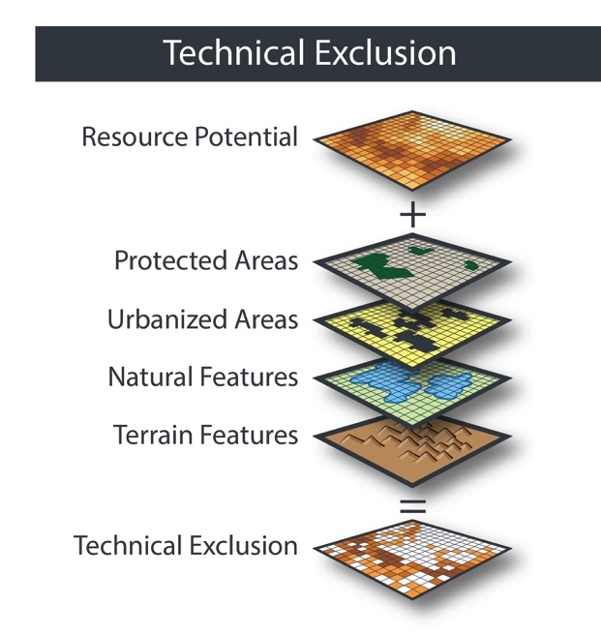
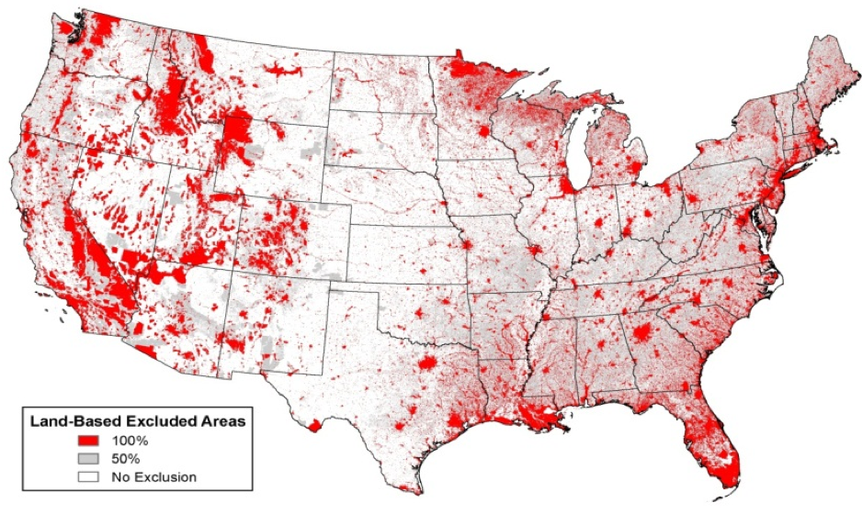
Principal modules of reV: Technical Exclusion
The technical exclusion module provides a framework for limiting the developable land available for renewable energy technologies
Slices of land can be either fully excluded or partially excluded.

Slide 13
Find Suitable Sites for Energy Development
Perform high-resolution site suitability analysis at local or national scales to assess potential for renewable energy deployment.
Assess many factors including:
Levelized cost of energy
Socio-environmental factors
Socio-political factors
Wildlife protection
Land-use restrictions
Proximity to critical infrastructure
More.

Slide 14
Exclusion Examples
Slope > 3.0%
Contiguous Area < 1.0 sq.km.
Urban Areas
Water and Wetlands
BLM Areas of Critical Environmental Concern
Forest Service Inventoried Roadless Areas
National Parks
Federally-Protected Lands
Parks, Wilderness, National Monuments, etc…

Slide 15
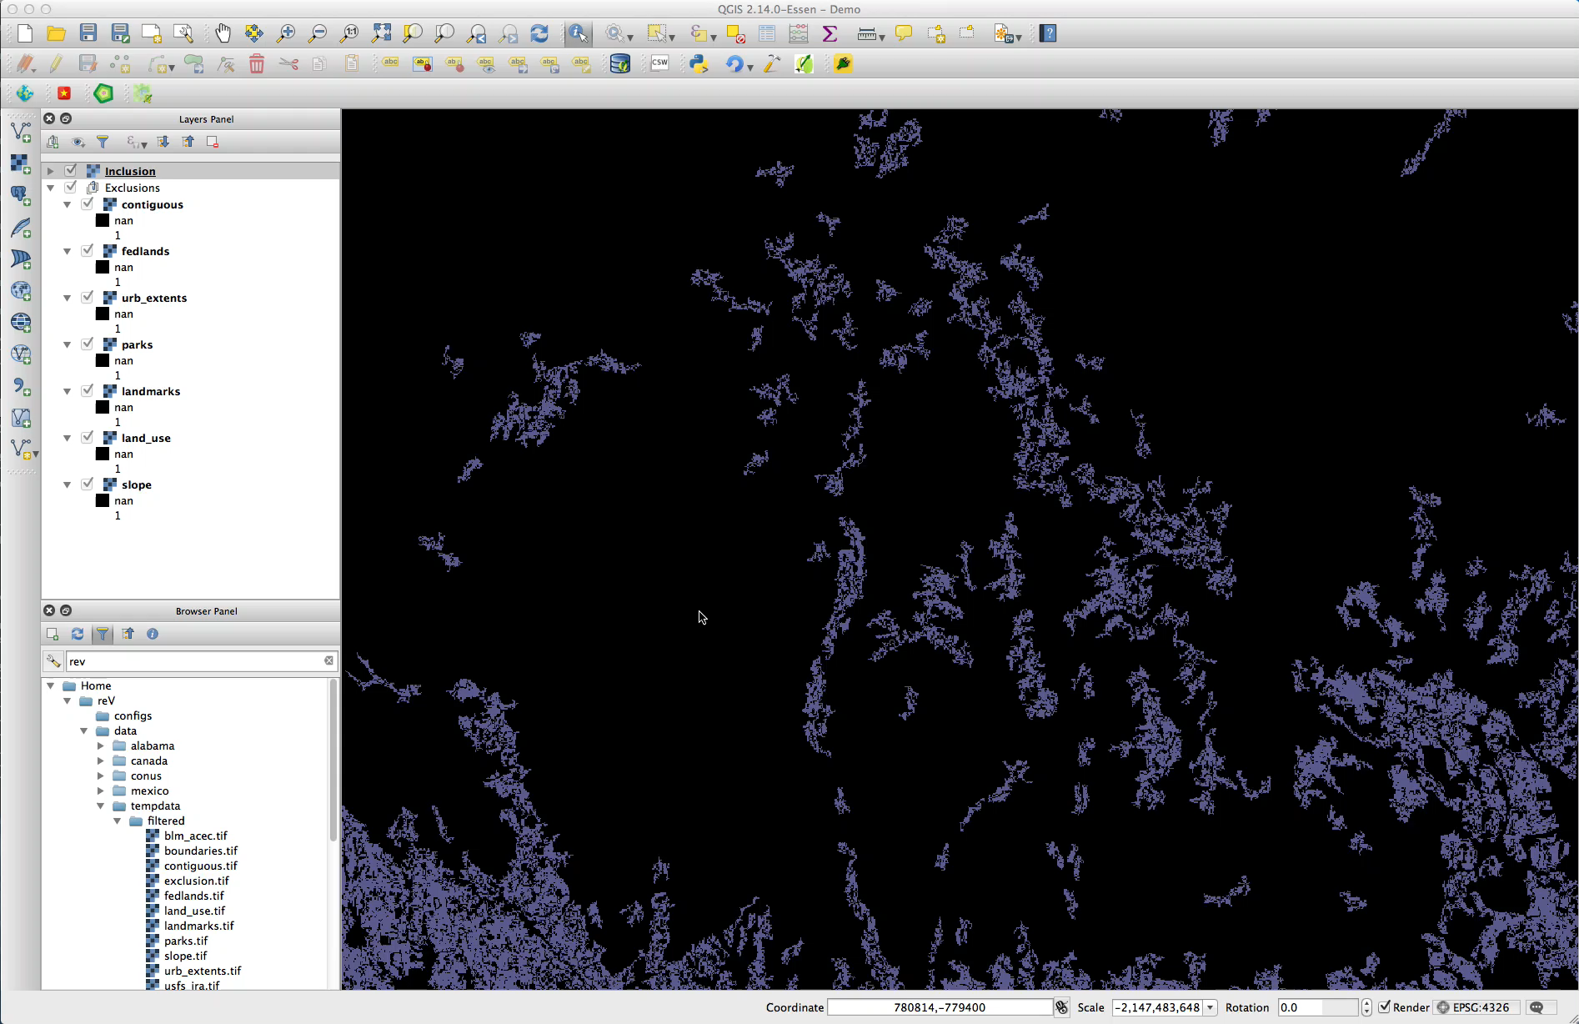
Exclusion / Inclusion Demo

Slide 16
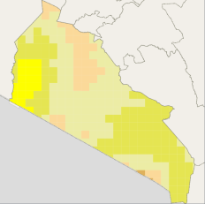
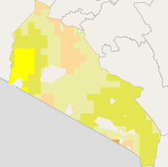
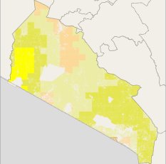
 | Baseline | Minimal Exclusions | Moderate Exclusions
Visualization
Exclusions | None | Protected Areas | Protected Areas Croplands
Nameplate Capacity (MW) | 1,044,606 | 978,424 | 899,919
Total Land Area (sq.km.) | 21,762 | 20,383 | 18,748
DC Generation (MWh/Yr) | 1,504,328,768 | 1,410,590,570 | 1,300,118,197

Slide 17
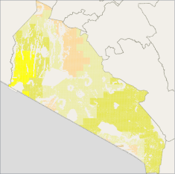
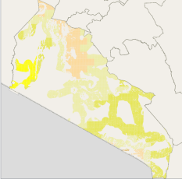
 | High Exclusions | Strict Exclusions
Visualization
Exclusions | Protected Areas Croplands Slope > 5% | Protected Areas Croplands Slope > 5% Distance to Road > 5km
Nameplate Capacity (MW) | 762,872 | 503,754
Total Land Area (sq.km.) | 15,893 | 10,494
DC Generation (MWh/Yr) | 1,105,799,235 | 717,350,757

Slide 18
 | Baseline | Strict Exclusions
Visualization
Exclusions | None | Protected Areas Croplands Slope > 5% Distance to Road > 5km
Nameplate Capacity (MW) | 1,044,606 | 503,754
Total Land Area (sq.km.) | 21,762 | 10,494
DC Generation (MWh/Yr) | 1,504,328,768 | 717,350,757
Difference
-540,852
-11,268
-786,978,011

Slide 19

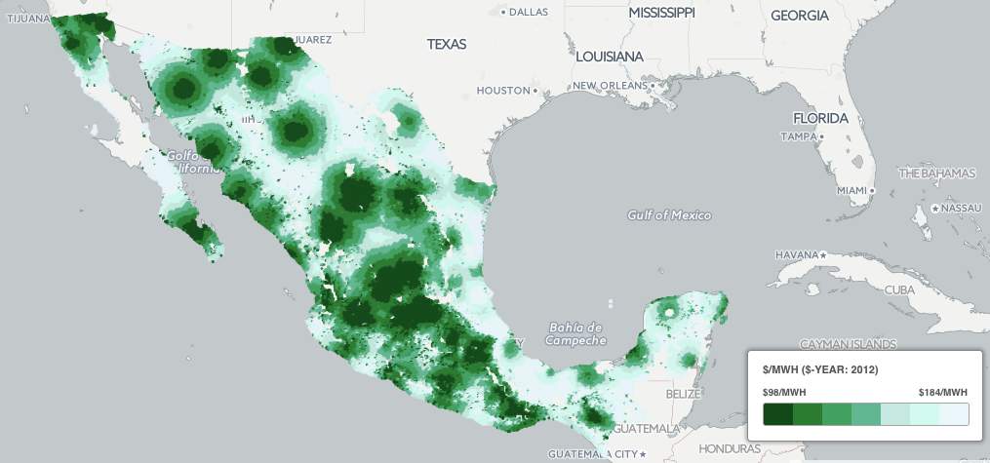
Principal modules of reV: Supply Curve Model
The supply curve models the transmission cost, energy cost and regional competition to estimate supply and cost

Slide 20
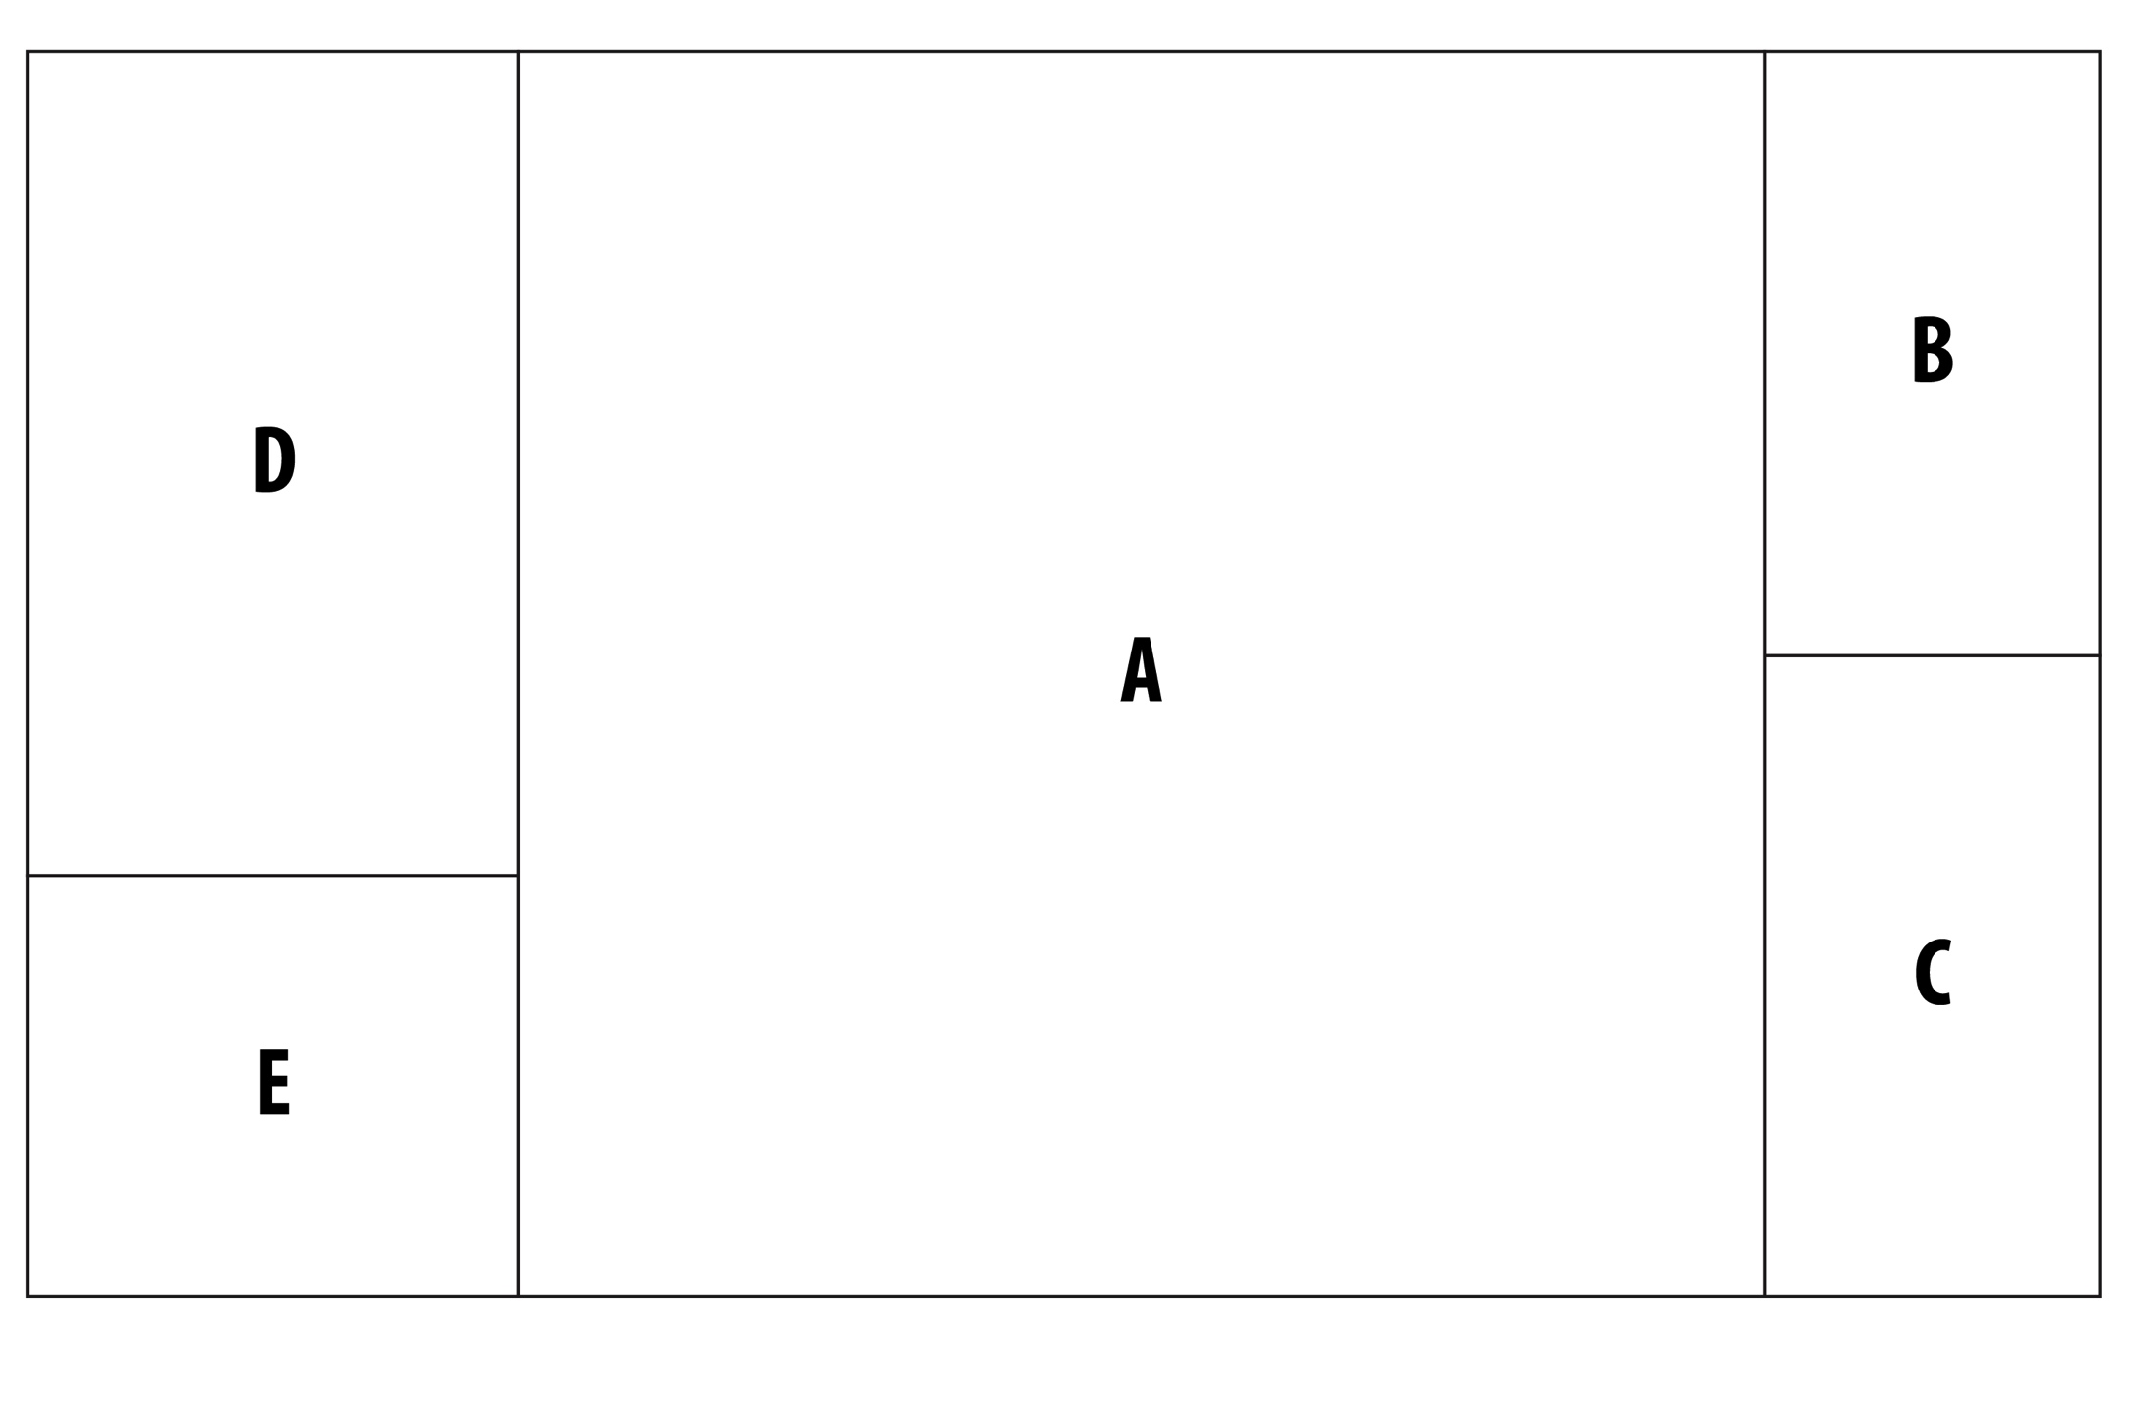
Principal modules of reV: Supply Curve Model

Slide 21

Principal modules of reV: Supply Curve Model

Slide 22
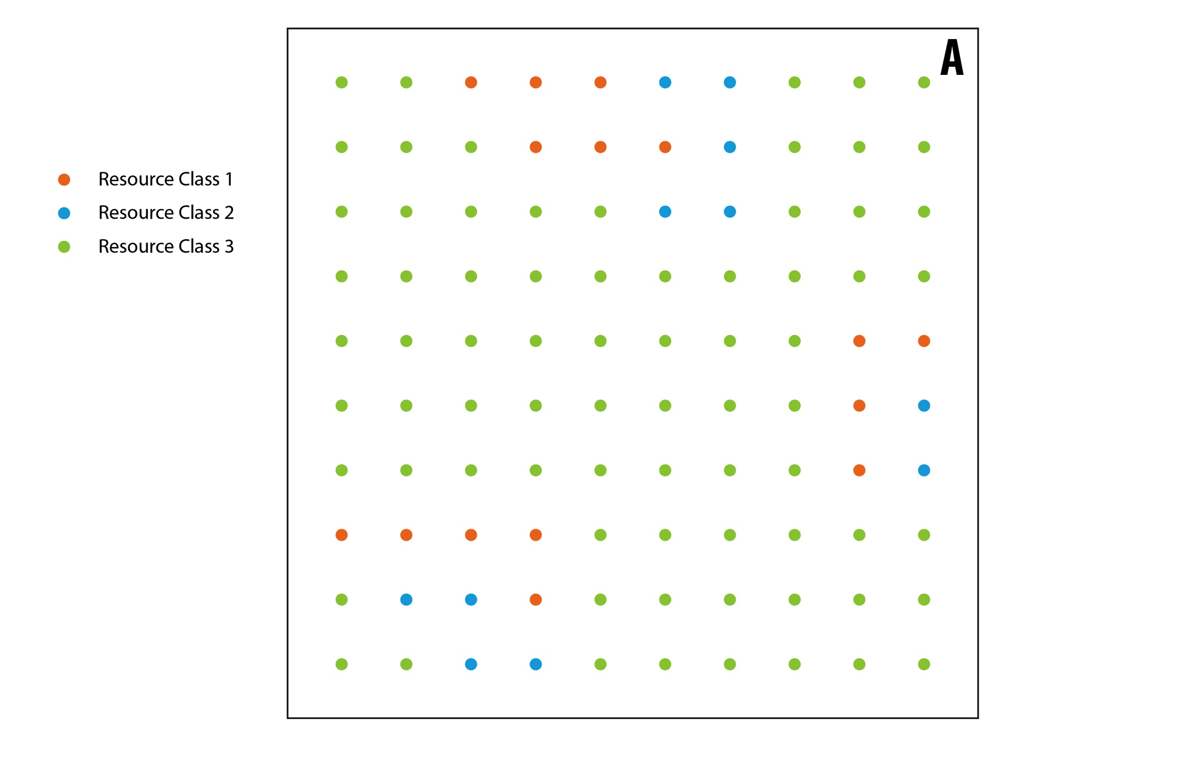
Principal modules of reV: Supply Curve Model

Slide 23
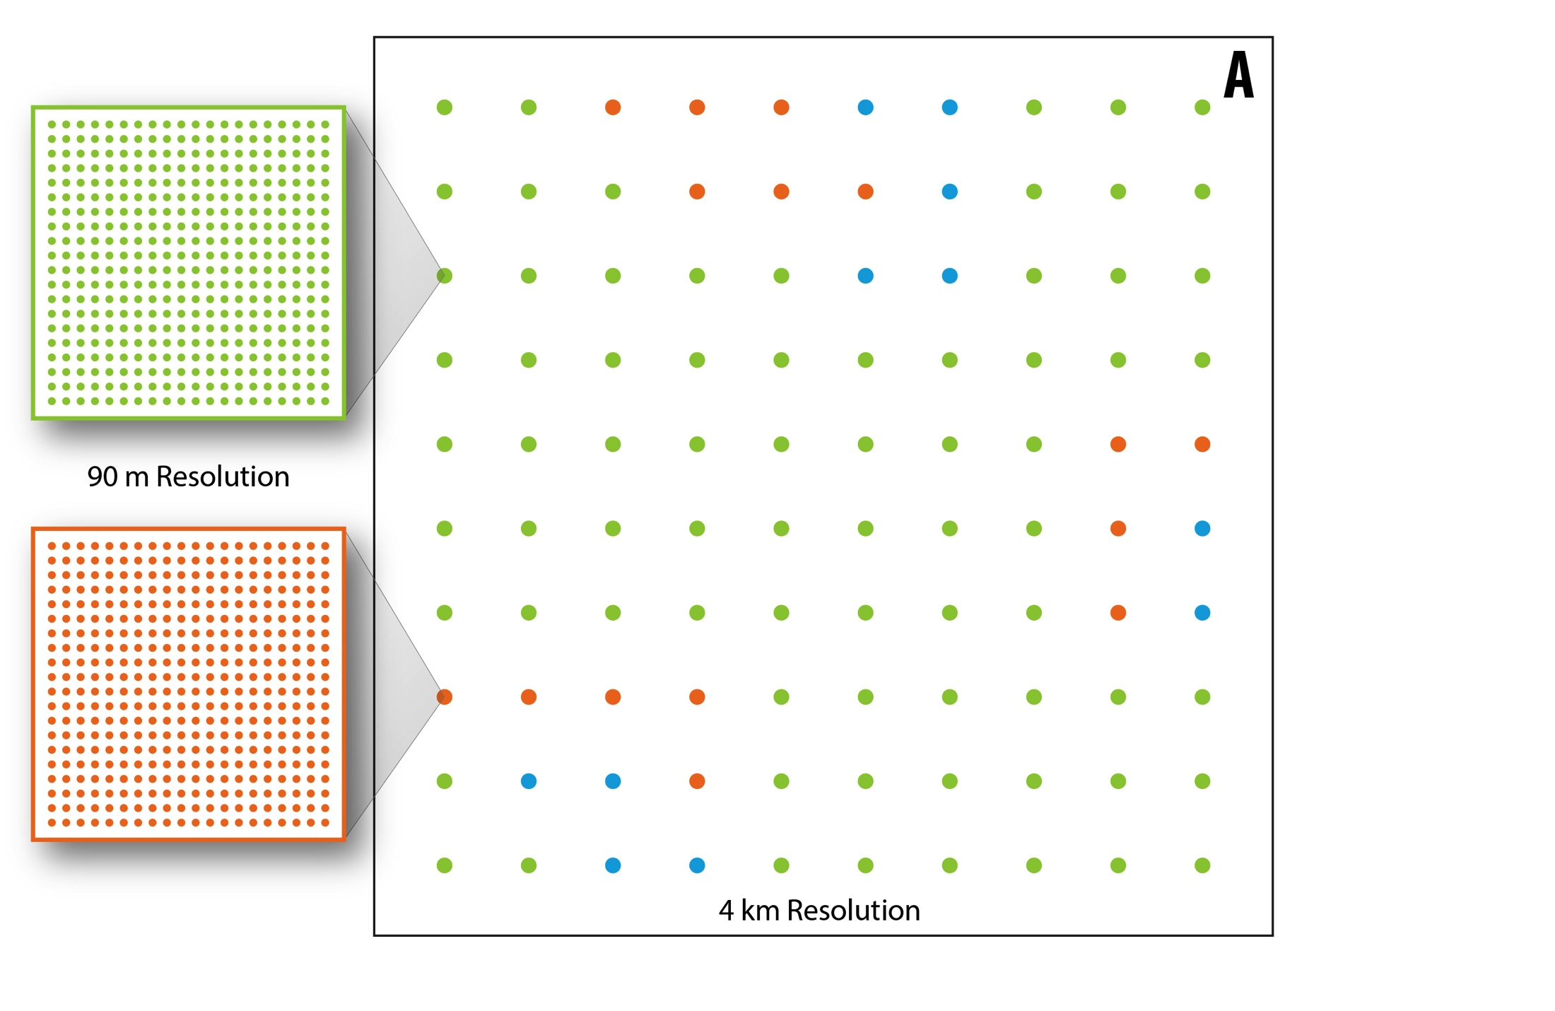
Principal modules of reV: Supply Curve Model

Slide 24
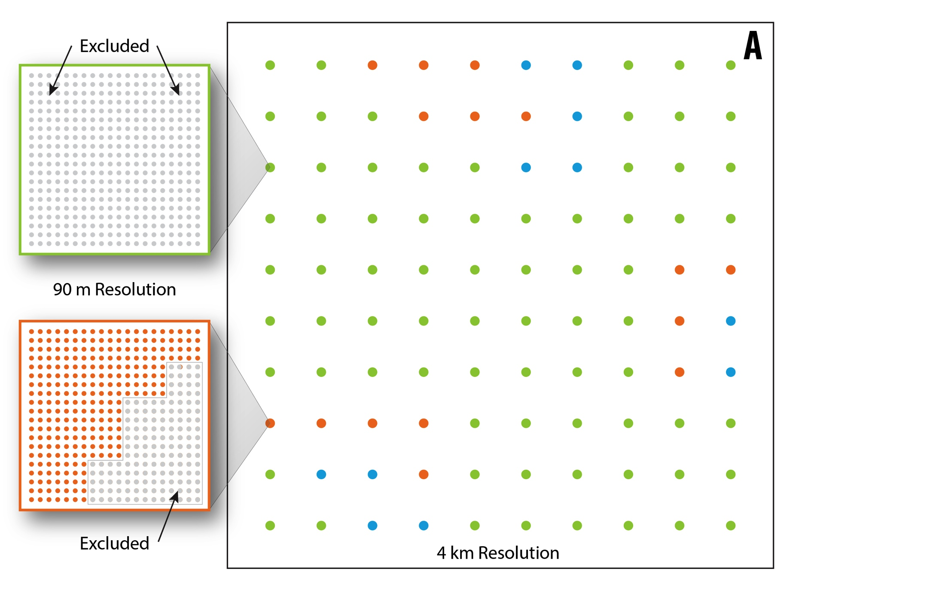
Principal modules of reV: Supply Curve Model

Slide 25
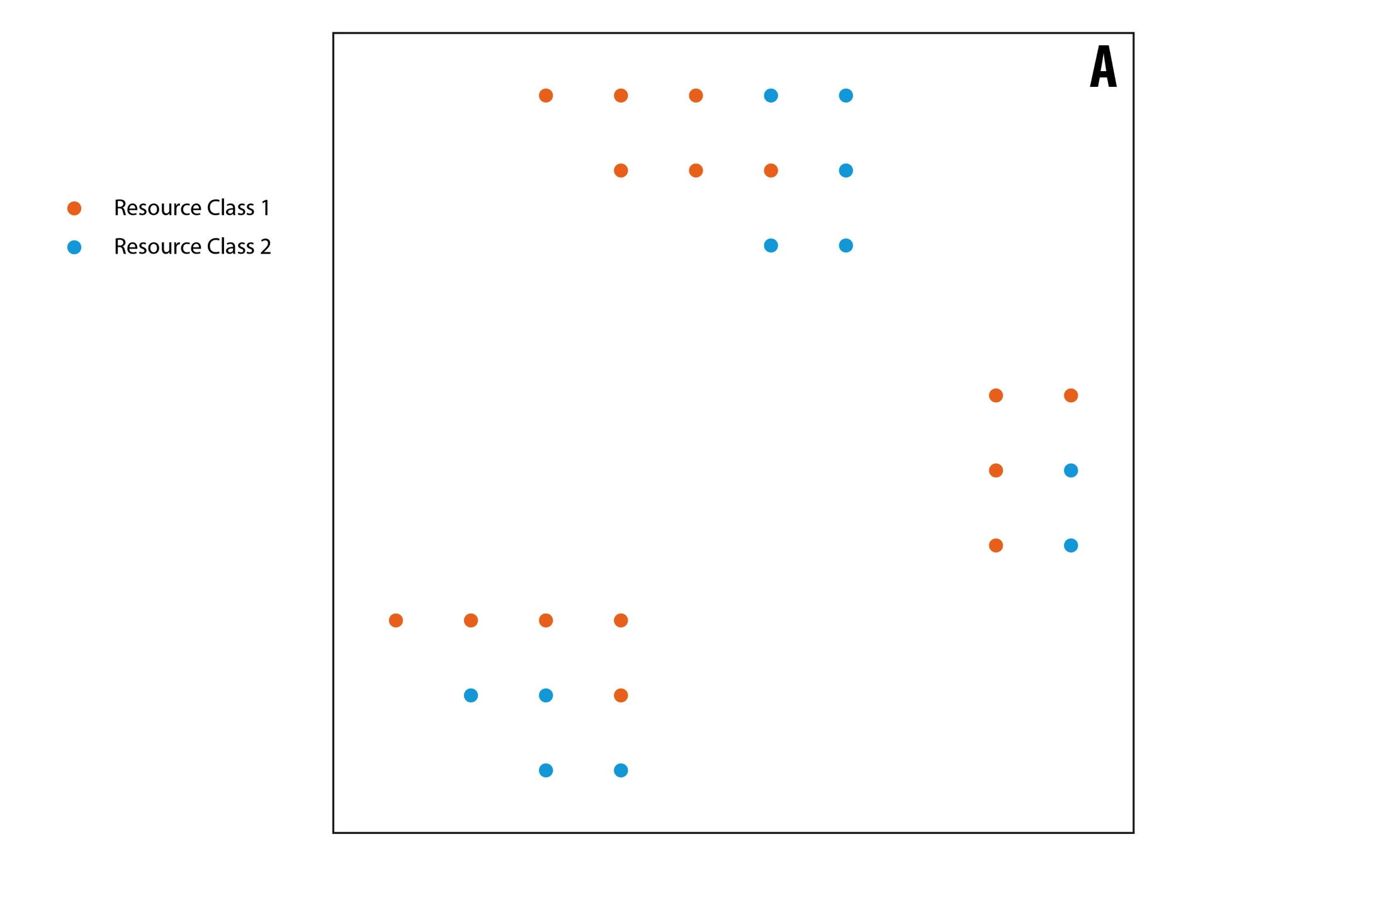
Principal modules of reV: Supply Curve Model

Slide 26
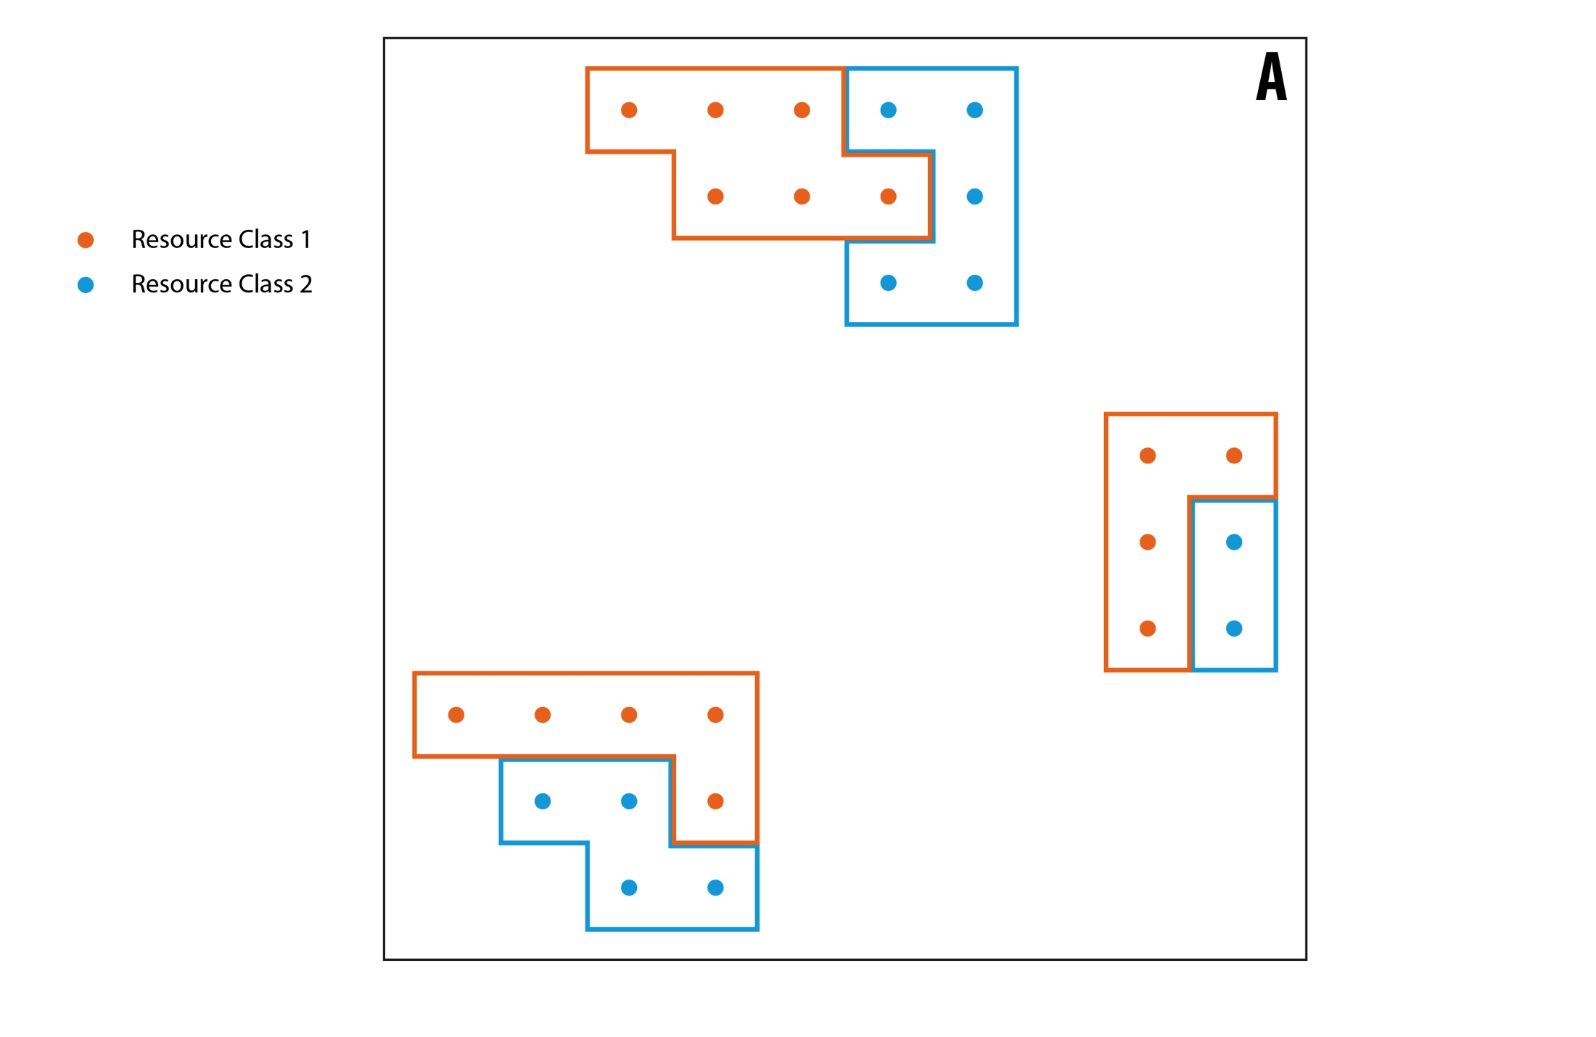
Principal modules of reV: Supply Curve Model

Slide 27
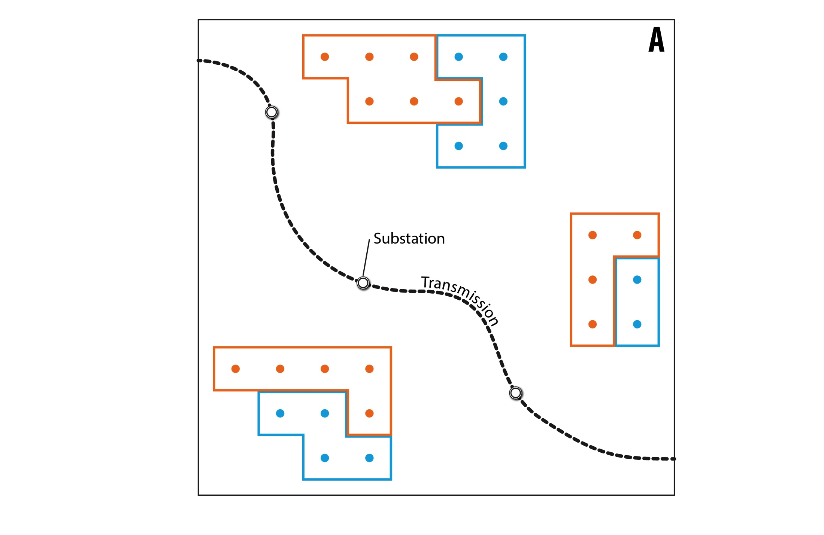
Principal modules of reV: Supply Curve Model

Slide 28
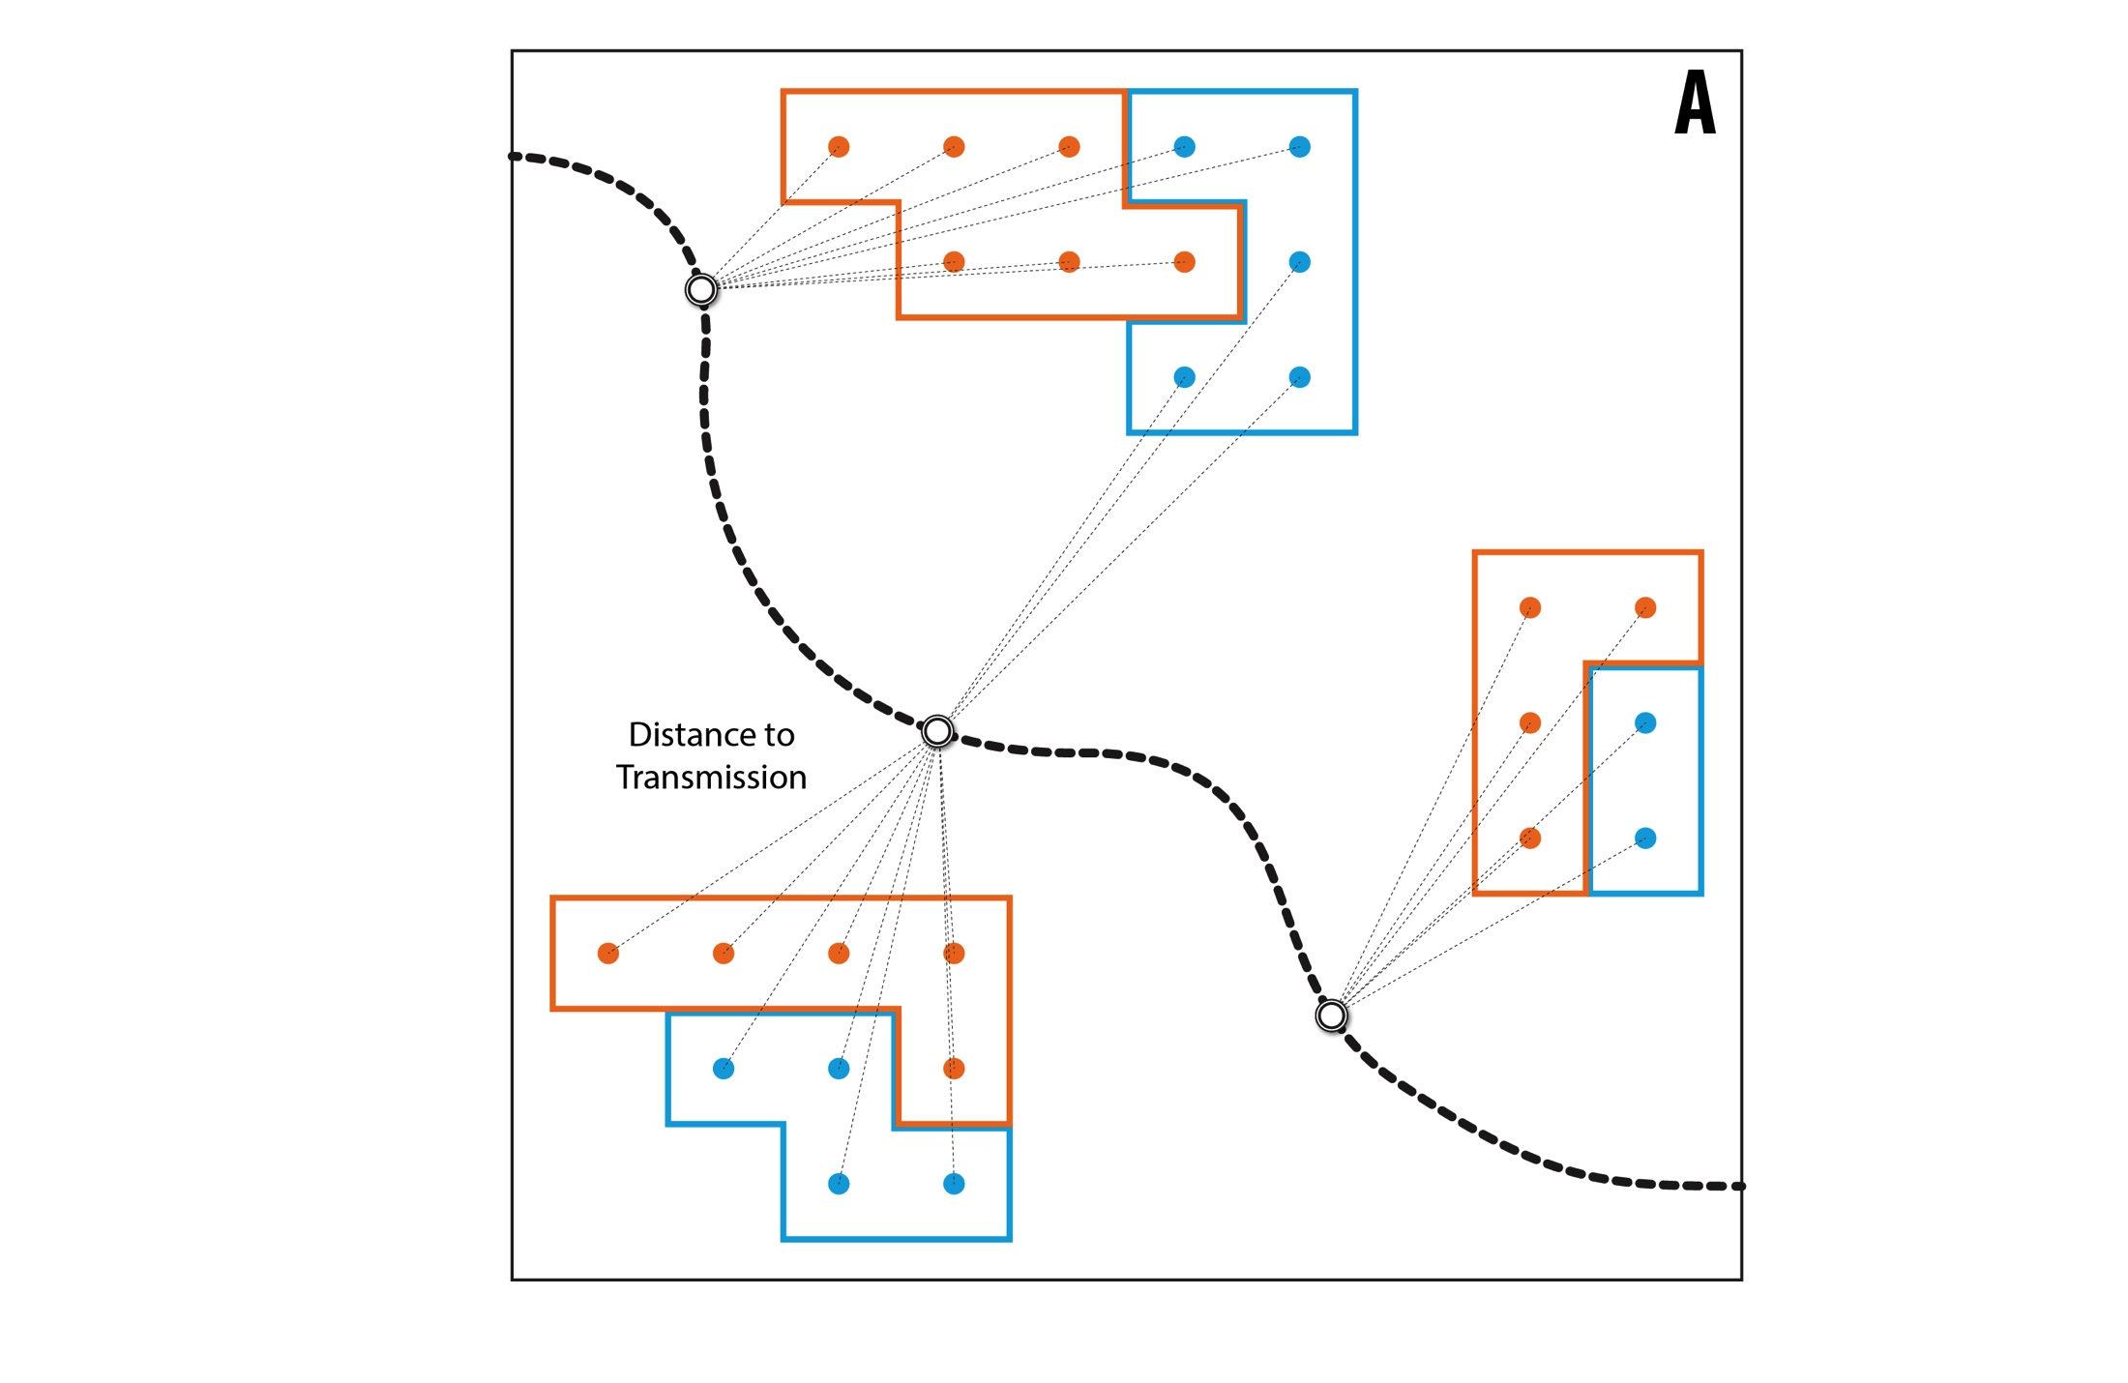
Principal modules of reV: Supply Curve Model

Slide 29
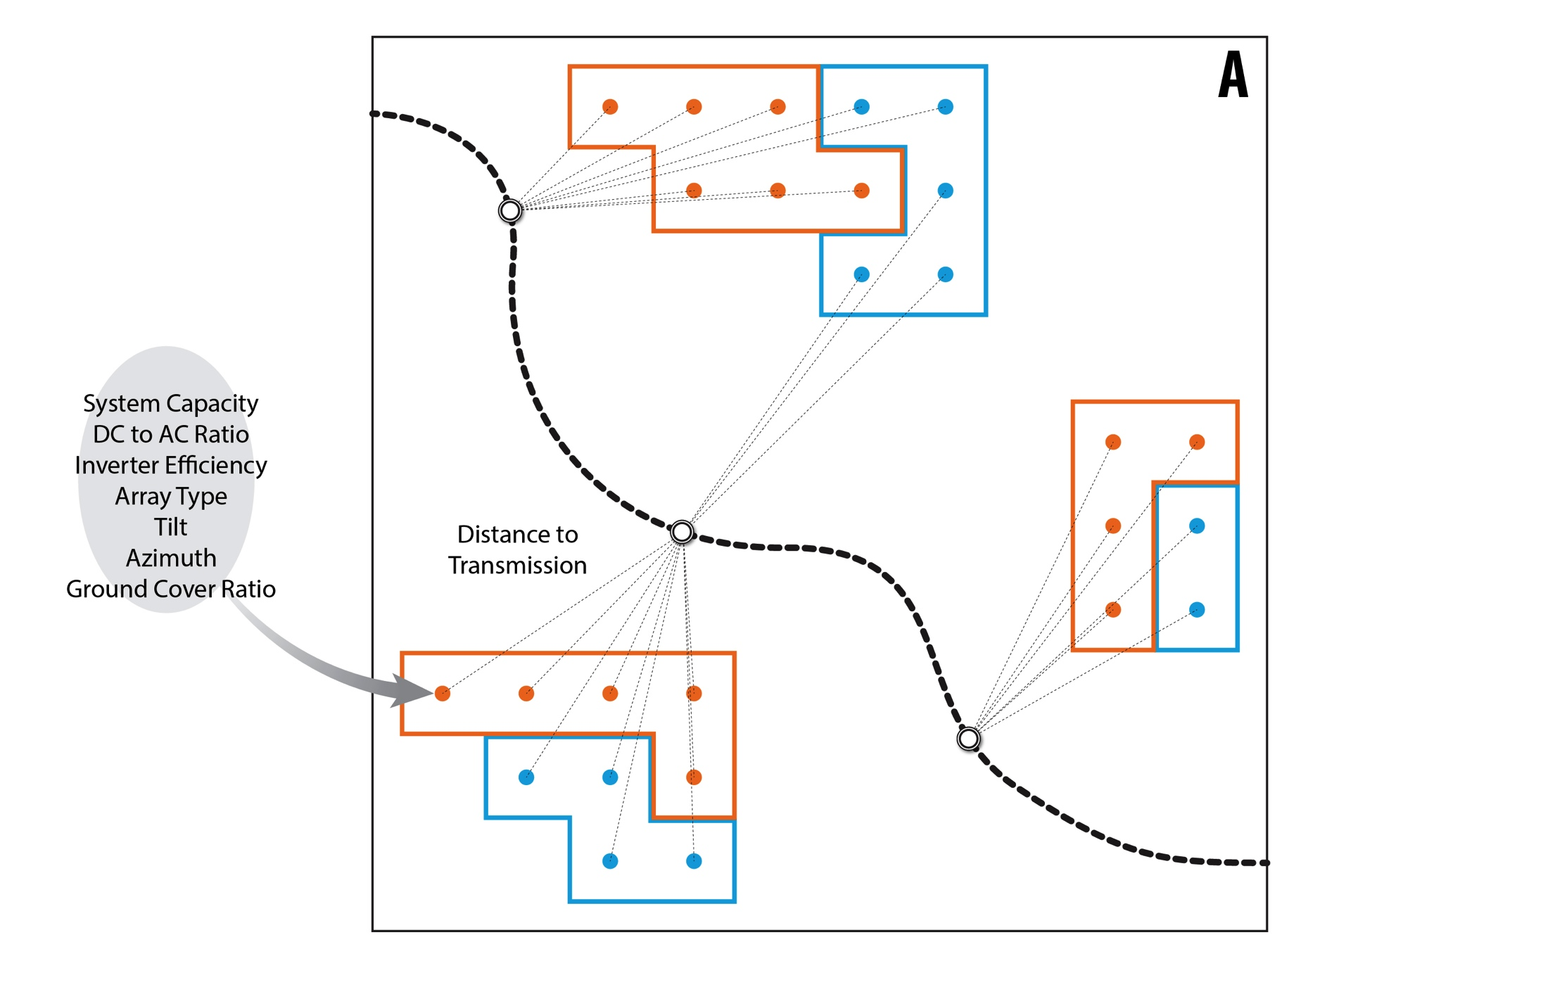
Principal modules of reV: Supply Curve Model

Slide 30
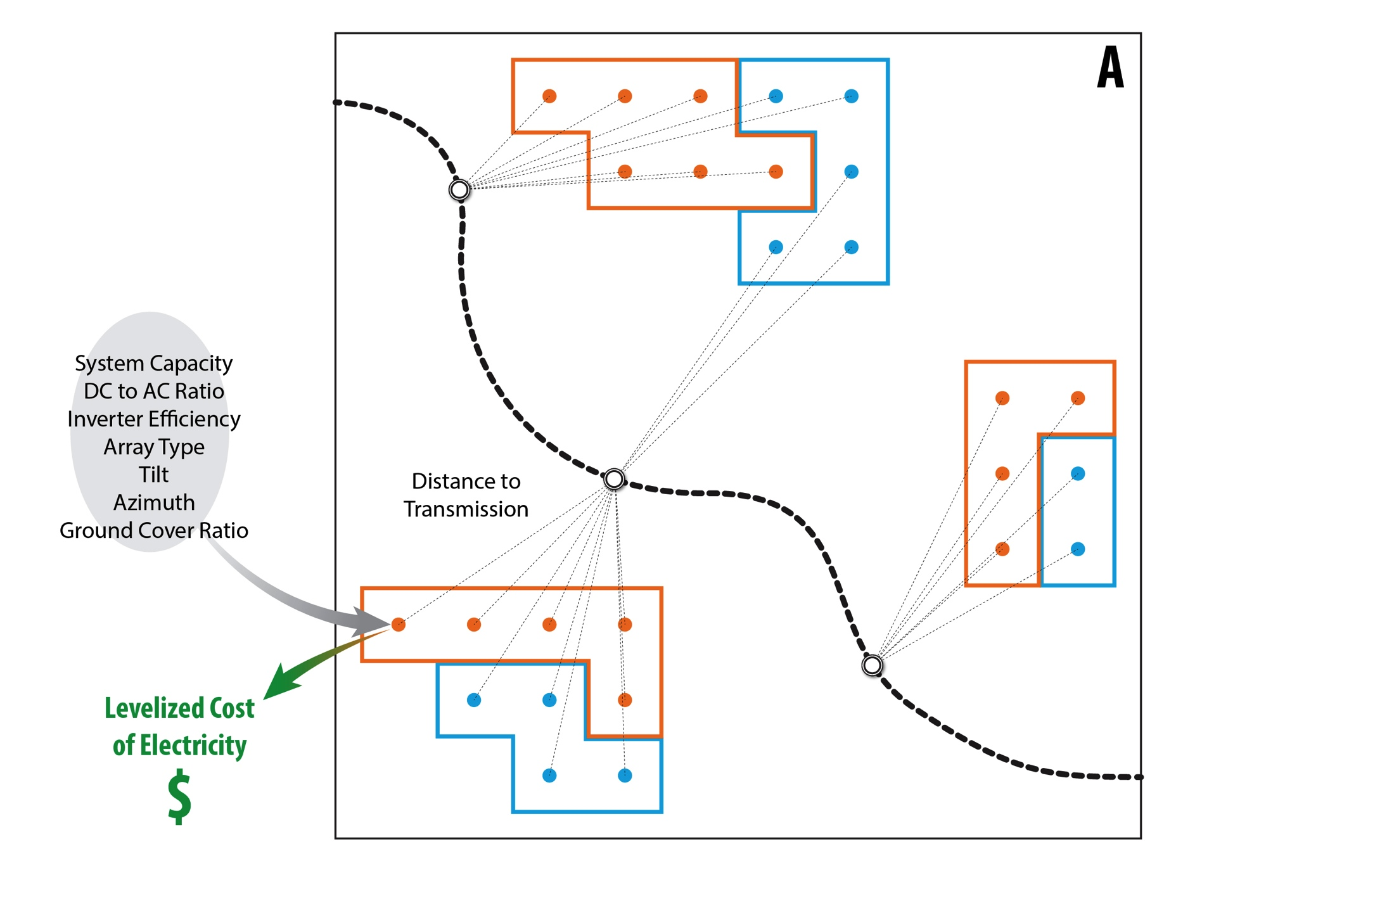
Principal modules of reV: Supply Curve Model

Slide 31
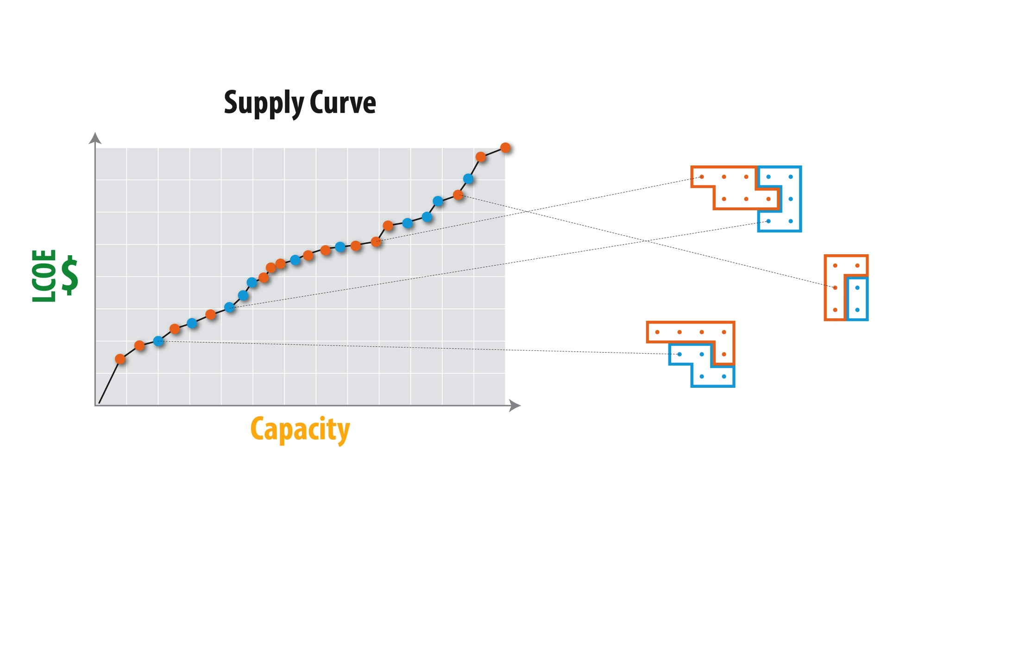
Principal modules of reV: Supply Curve Model

Slide 32
Analysis
Resource points find all connections to grid within a certain distance
Costs of connection to that grid object taken into account
Build list of all possible connections of resource points to grid
Scan through list, making cheapest connections first
As grid objects reach maximum capacity, resource points forced to look for next cheapest connection
If no connections possible to grid, resource point connects to nearest BA Load Center. This signifies necessity to build more infrastructure to connect that resource point
All resource points retained in final dataset
Resulting dataset provides $/MW to connect that particular resource point

Slide 33
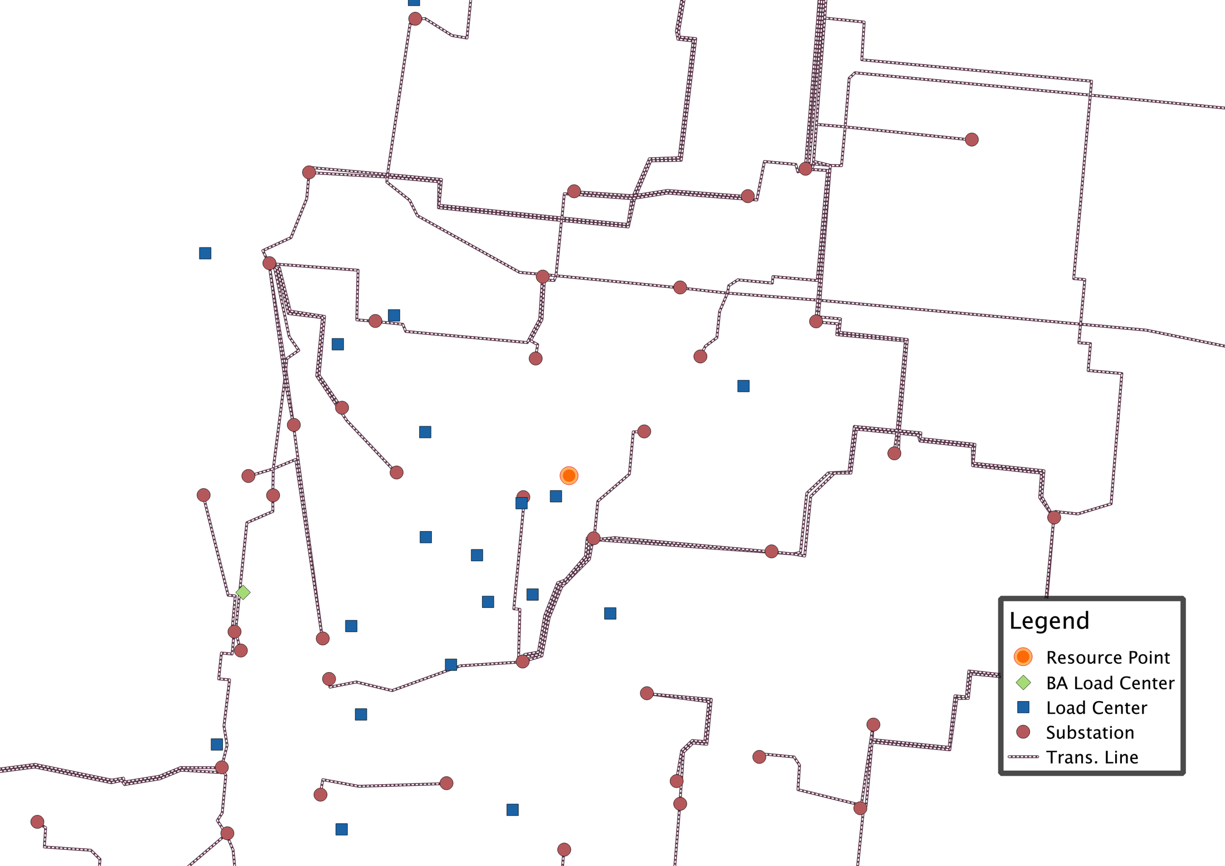
Analysis

Slide 34
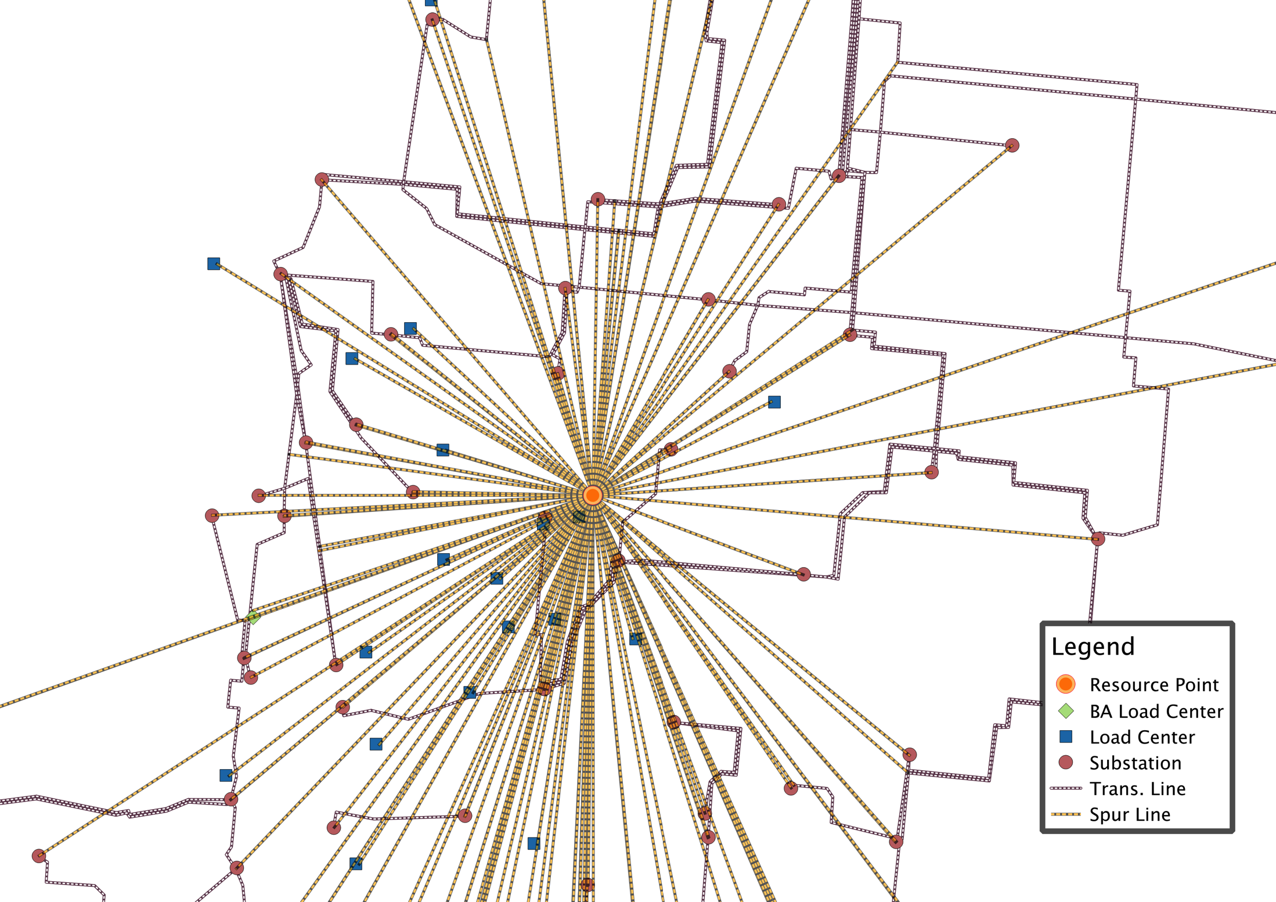
Analysis

Slide 35
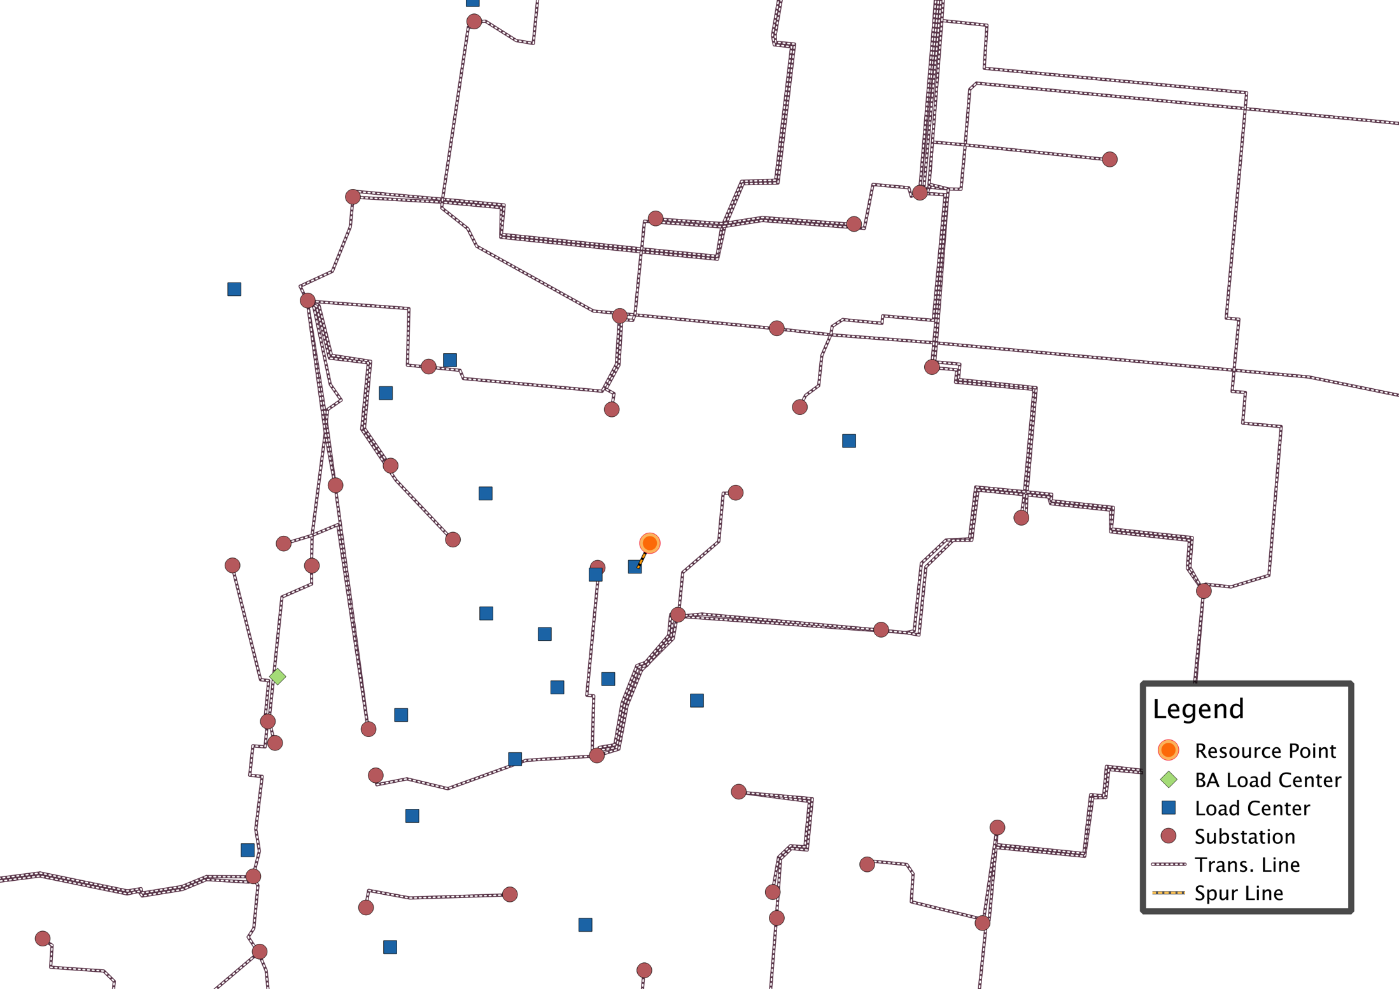
Analysis

Slide 36
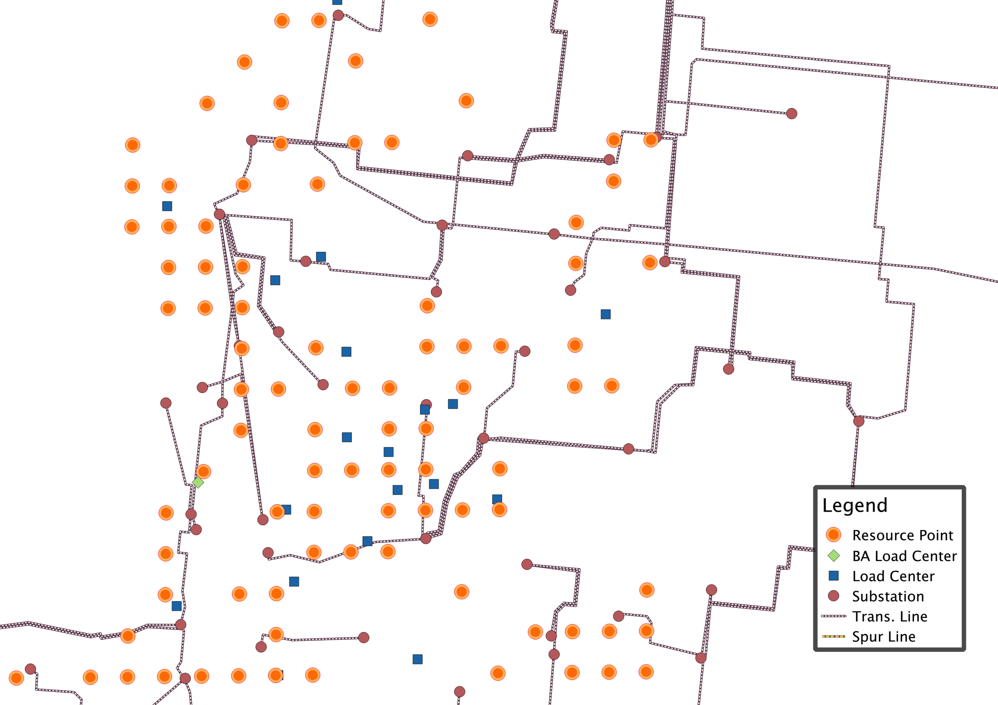
Analysis

Slide 37
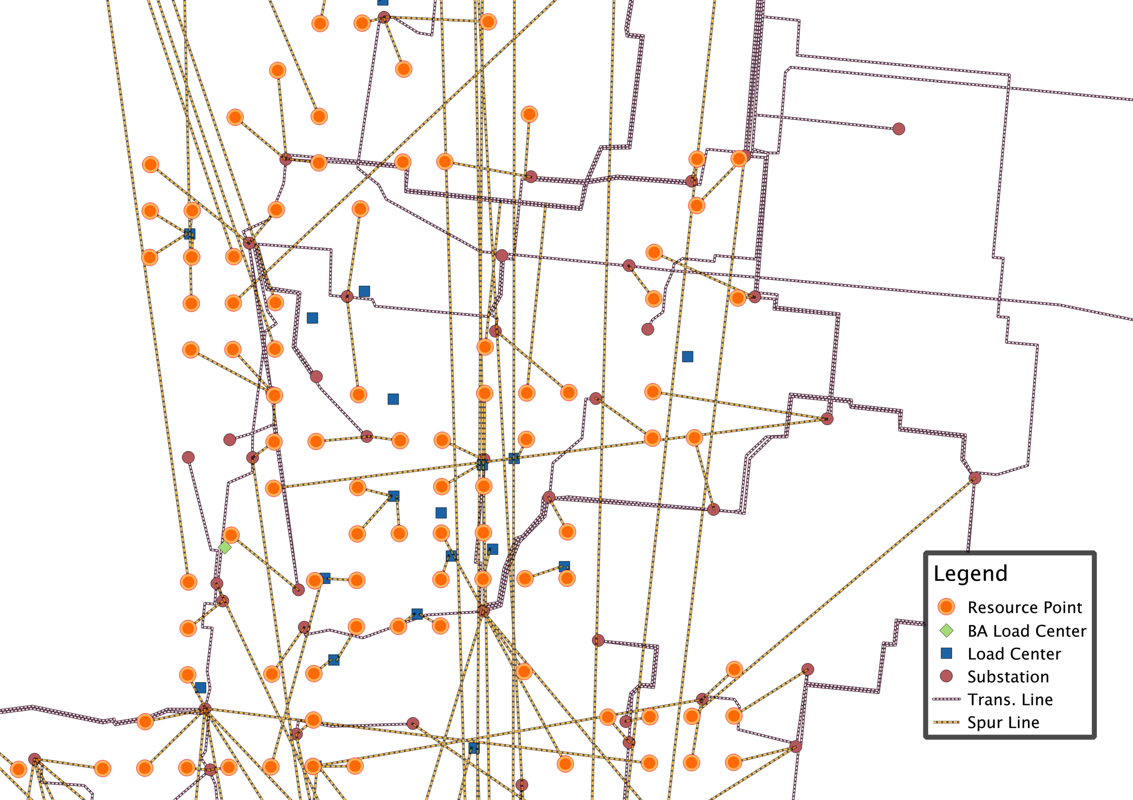
Analysis
Notes:
----- Meeting Notes (7/24/15 09:55) -----
Transformer costs?

Slide 38
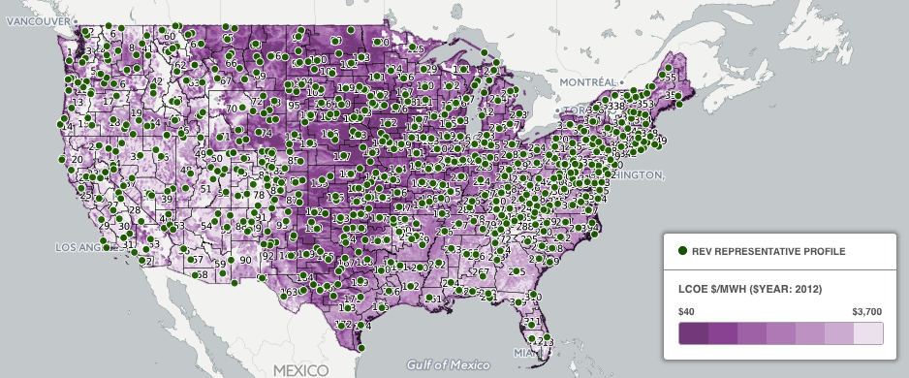
Principal modules of reV: Representative Profiles
The representative profiles module selects a single profile from each resource class within each resource region
Methods currently available:
Meanoid
Future support:
Medianoid
Distribution-based approaches

Slide 39
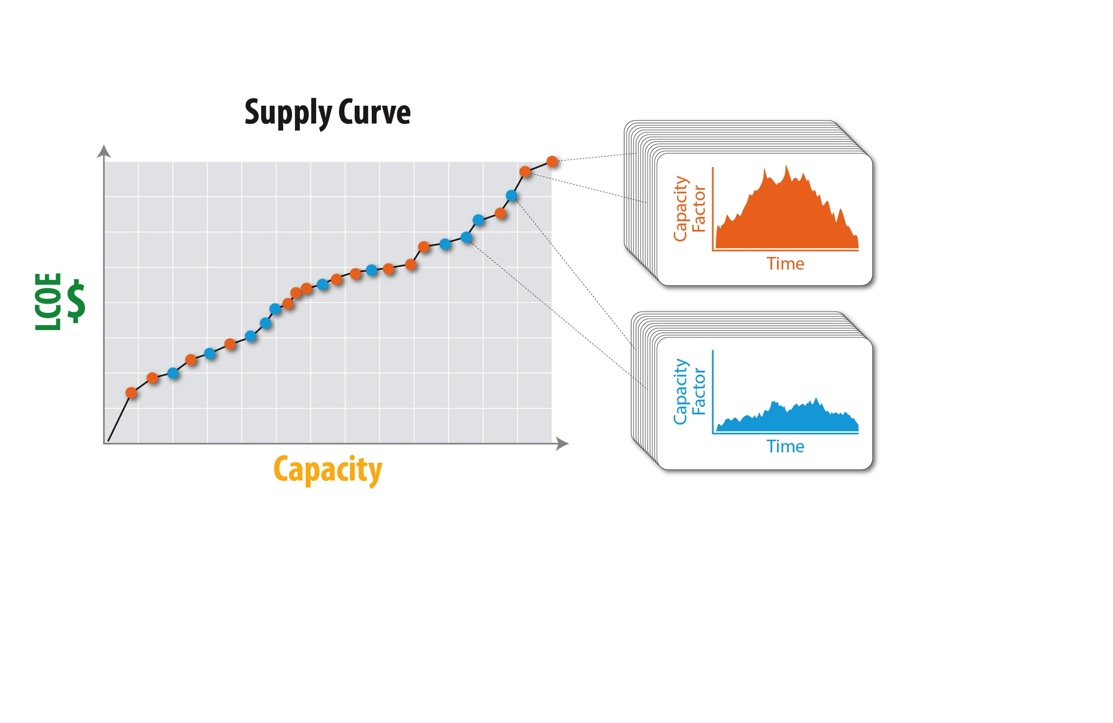
Principal modules of reV: Representative Profiles

Slide 40
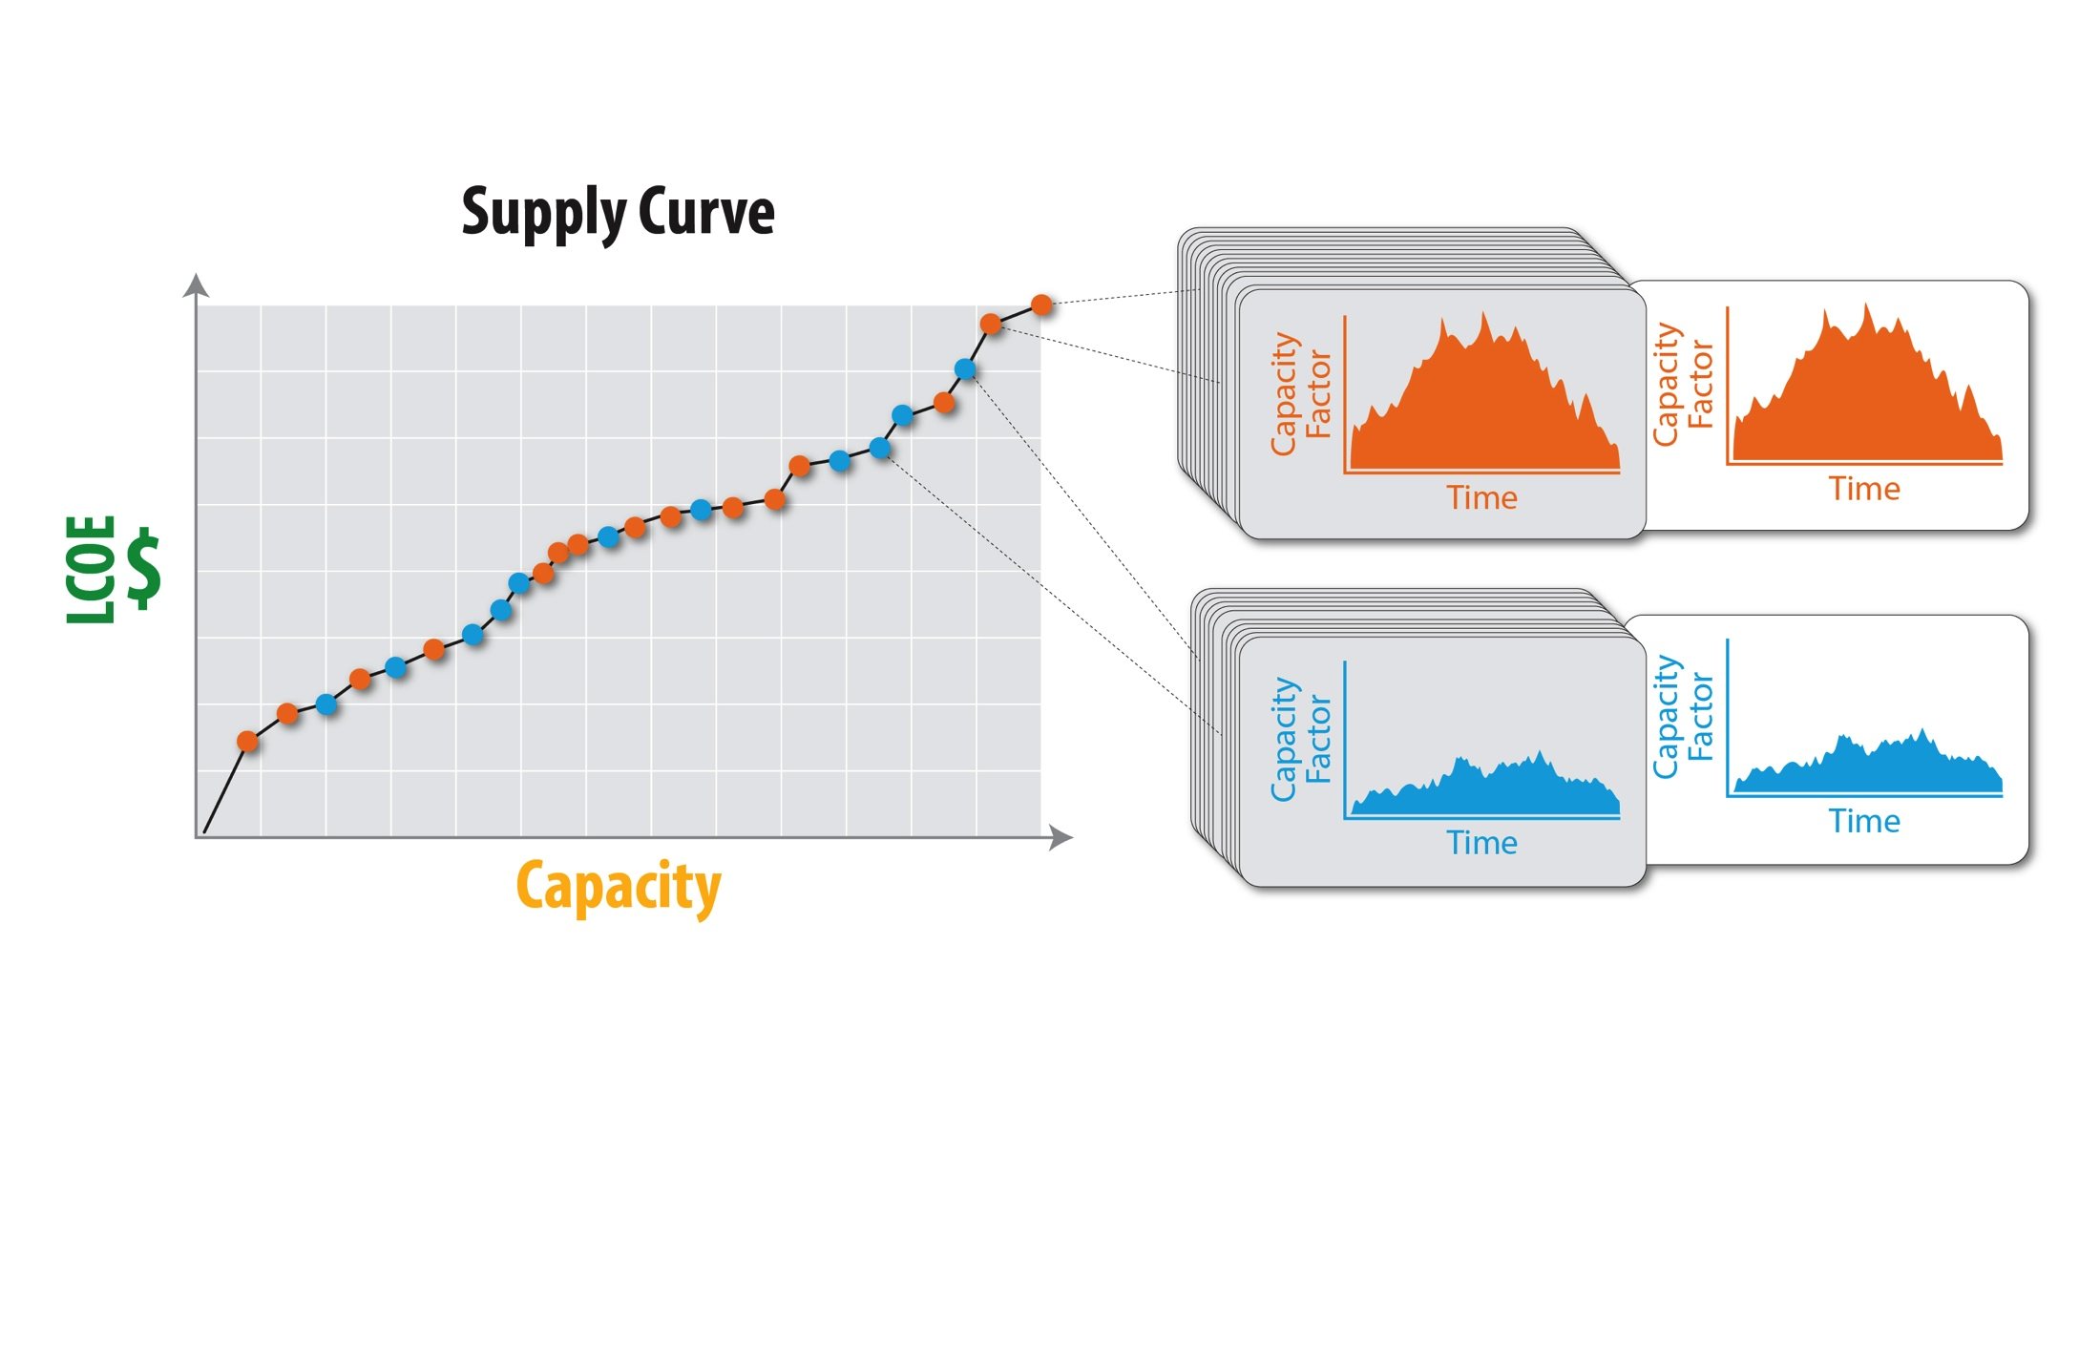
Principal modules of reV: Representative Profiles

Slide 41
Principal modules of reV
reV lets you analyze renewable resources with techno-economic, regulatory, sociopolitical, and environmental factors
Summary Modules:
Exceedance probabilities
Visualization
Plotting/Summarize

Slide 42
Thank You! For additional information on using reV to solve your energy challenges, contact Anthony Lopez Anthony.Lopez@NREL.gov or Galen Maclaurin Galen.Maclaurin@NREL.gov

Slide 43
Extra Slides

Slide 45
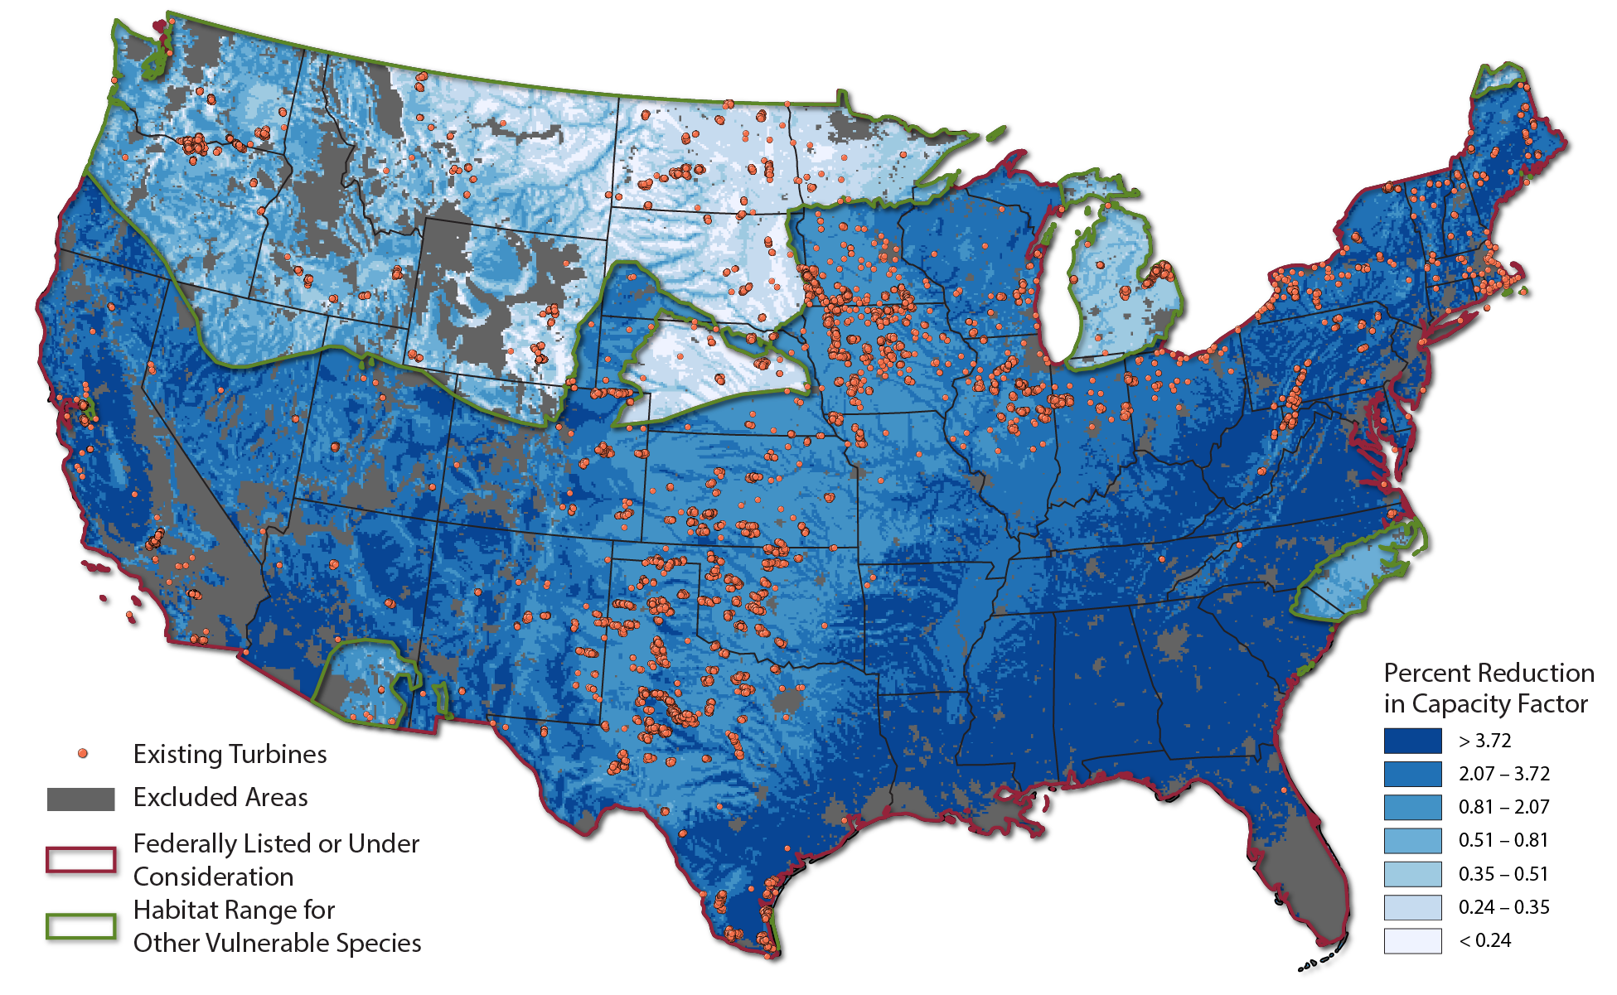
Wind-Wildlife Mitigation: Curtailment Scenarios
*High Scenario: Curtail generation when wind speed is below 6.9 m/s (red) or 5 m/s (green) from April through October

Slide 46
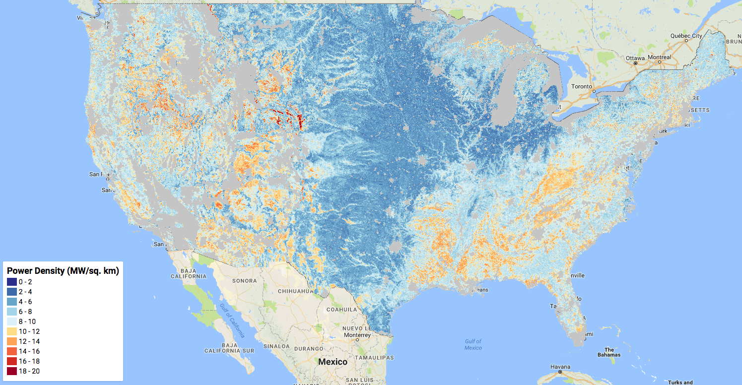
Variable Power Density

Slide 47
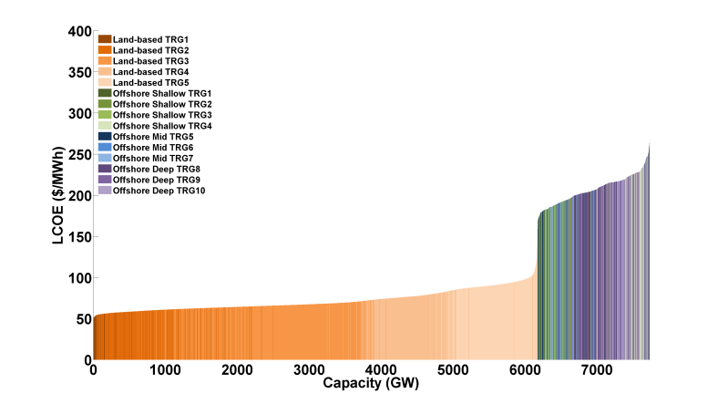
Assess Economic Potential and Model Capacity Expansion
Supply curves represent a blending of plant siting, interconnection cost, energy cost, energy value, and regional competition to provide a geographically discrete, national estimate of renewable energy supply and cost.
Notes:
1. reV merges all of the concepts together to create supply curves
2. reV evaluates grid connection costs
3. reV knows at very high spatial res where resources are and how much they cost

Slide 48
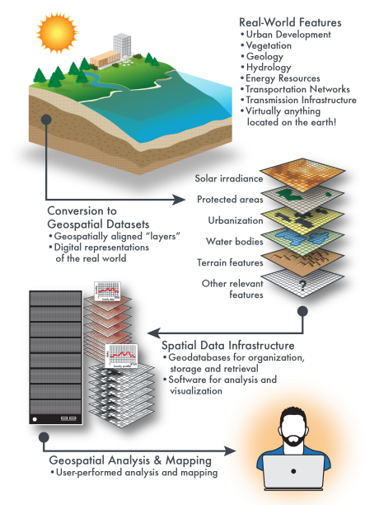
Robust Data for Rich Analysis
½ Petabyte Solar and wind resource data
100s
of geospatial data layers
Notes:
reV accesses more than ½ petabyte of spatiotemporal solar and wind resource data spanning North and Central America and South Asia.
Solar: National Solar Radiation Database
Wind: WIND Toolkit
reV accesses hundreds of geospatial layers collected and maintained in NREL’s geospatial database

Slide 49






Software Platform: Extensible, Modular, Integrated
reV integrates NREL’s spatial analysis engines with the System Advisor Model (SAM), PLEXOS, and other tools to enable robust, spatially resolved generation and financial modeling.
Notes:
reV, built in Python, is a complex, extensible, and modular framework developed on NREL’s flagship high performance computer, Peregrine.
reV provides critical data feeds for a diverse set of models, each with varying degrees of spatial and temporal requirements. reV outputs are tailored for specific model needs.
Progress is being made in increasing reV output interoperability between models given increased model integration

Slide 50
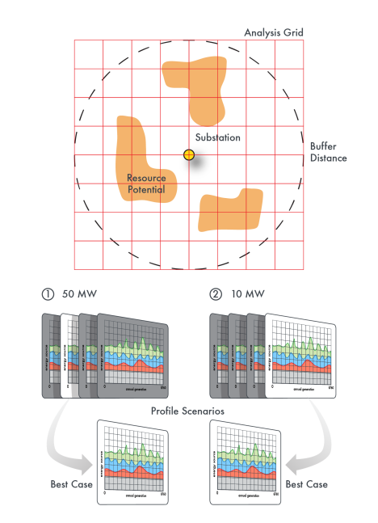
Most Sophisticated Representation of Renewables
reV determines how best to characterize the supply and profile of resource when constrained to regional or nodal representation
Adjustable classification of resource provides additional resolution when required
Notes:
reV get's very complicated in it's evaluation of regional generation potential. It has the most sophisticated representation of renewables than ANY OTHER model.
reV knows how to smartly couple CEM outputs to PCM inputs. BETTER than any other model.

Slide 51
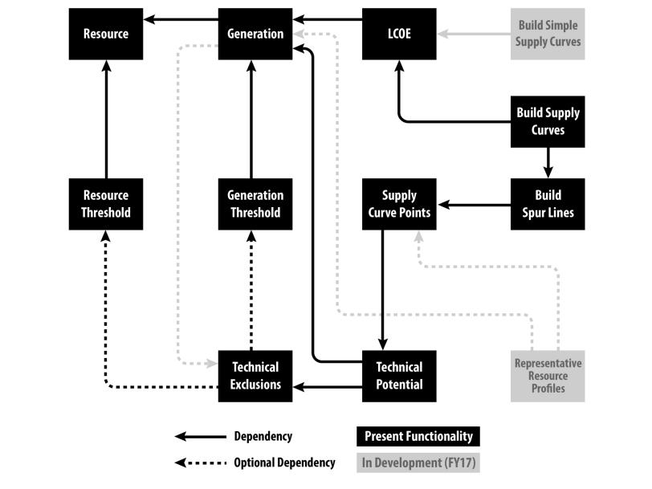
Framework Modules with Dependencies
Exceedance Probabilities

